Slide 1



Topological Matter School
August 19th, 2024
Correlations and Topology on Kagome lattices: Lecture 1
Stephen D. Wilson
Professor, Materials Department
University of California, Santa Barbara

Slide 2
Outline
Introduction to kagome lattice
  Qualitative overview of motivation to study kagome lattice
Kagome lattice Hubbard model
Kagome insulators
  Strong geometric, magnetic frustration
  Quantum spin liquids
Kagome metals
  Strong kinetic, hopping frustration
  Correlated metals

Slide 3
Introduction to kagome lattice

Slide 4
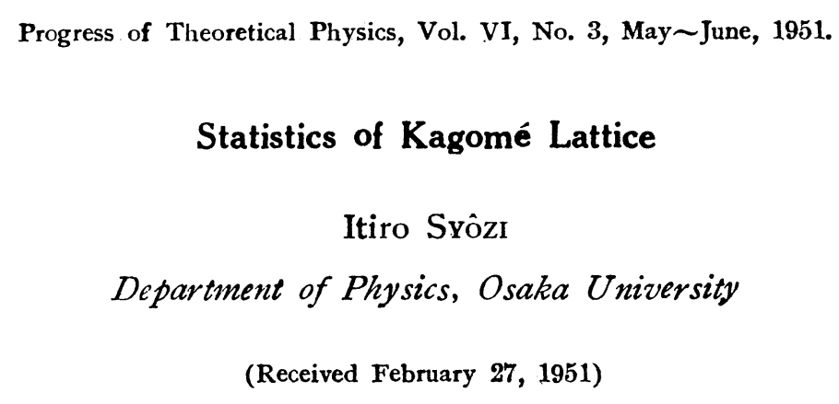
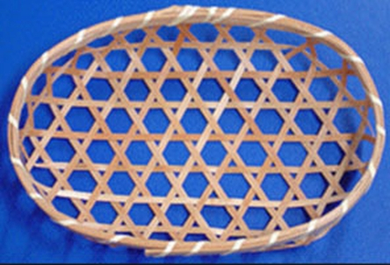
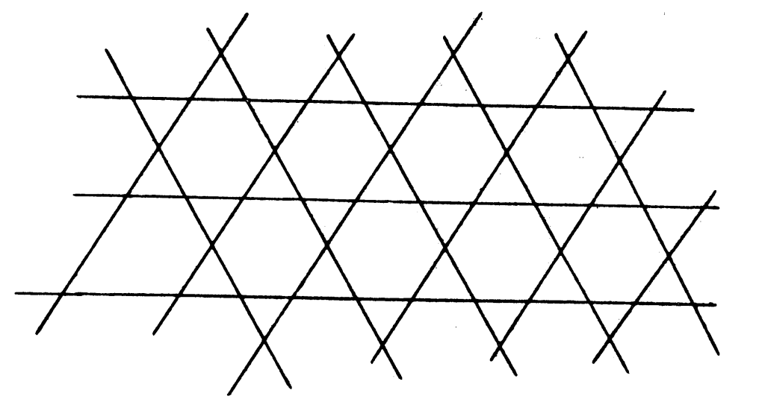
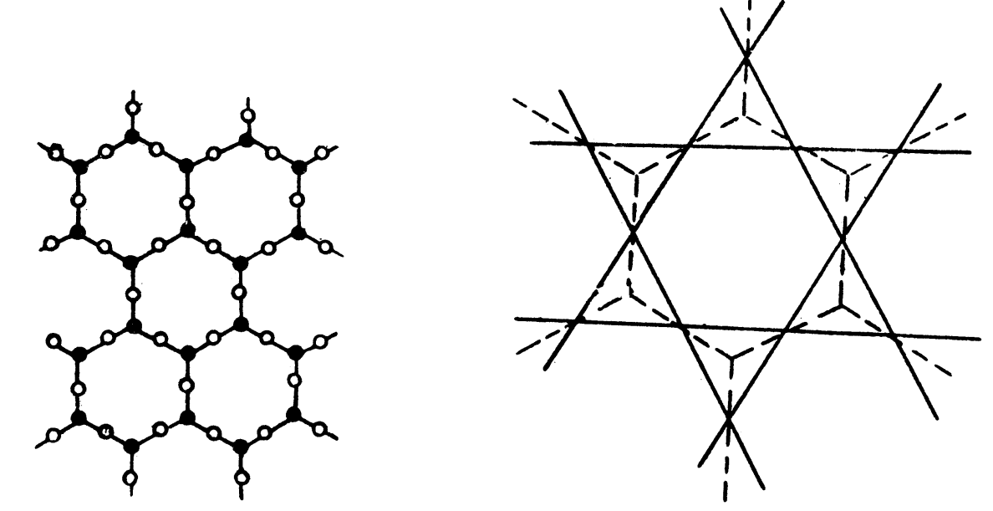
Origin of kagome lattice
Bamboo-basket weaving pattern
Kodi Husimi and Itiro Syôzi
Statistical model for spin physics
  Onsager, square lattice
  Temperley, honeycomb lattice
  Wannier, triangular lattice

Slide 5
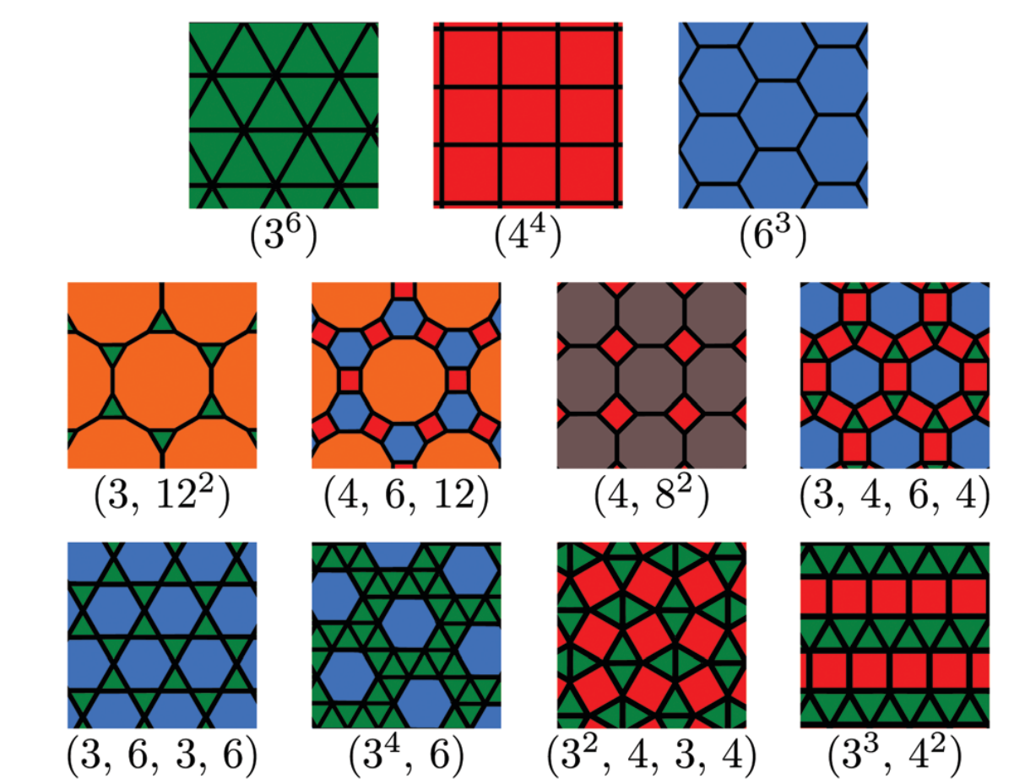
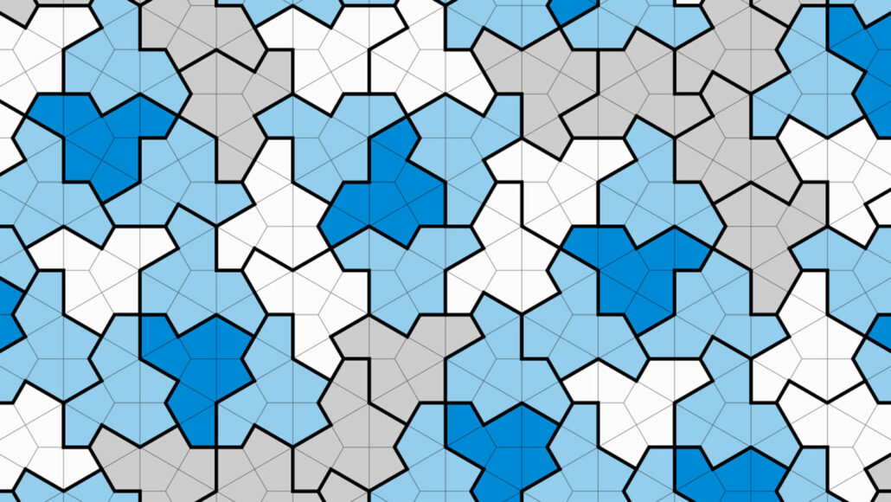
Kagome network as 2D tiling motif
Crasto de Lima et al., Phys. Chem. Chem. Phys. (2019)
11 Archimedean lattices
Tiling of regular polygons with vertices of the same type
Kagome tiling can be thought of as network of corner sharing triangles
Smith et al., arXiv:2303.10798 (2023)
*(Not this)

Slide 6
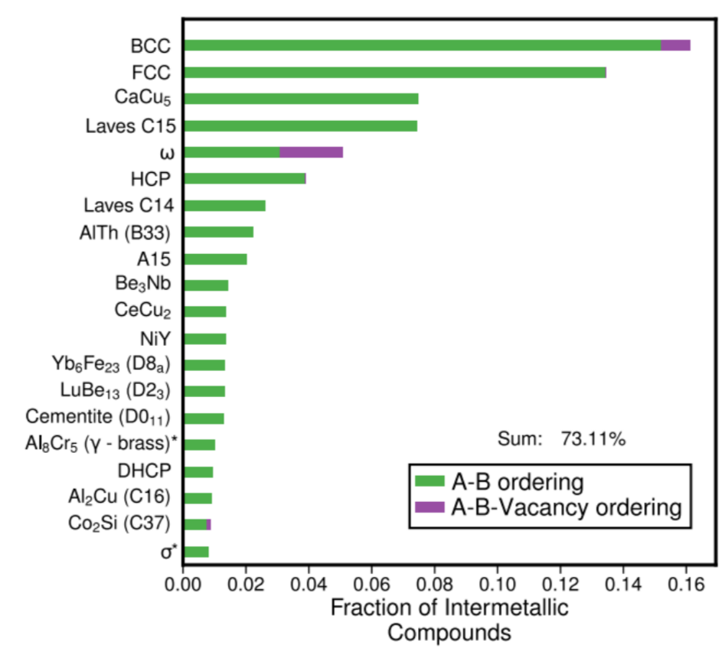
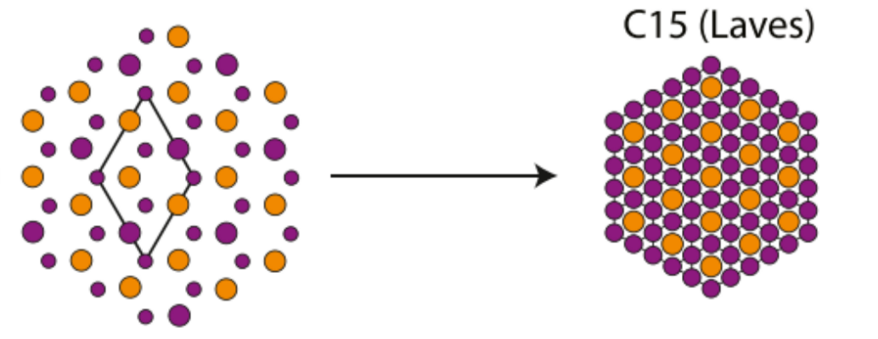
Kagome lattices in materials
Kagome networks found in many materials
Common example:
  Hexagonal close packed networks
  Make some balls small A₂B
  Favored superlattice forms with easy distortion pathways into kagome
Kolii et al., Phys. Rev. Mat. 4, 113604 (2020)
Kolii et al., Acta Materialia 221, 117429 (2021)
Notes:
Sqrt3 a x sqrt3 a superlattice favored when big balls and small balls in hcp. This can then distort into kagome

Slide 7
Kagome lattice Hubbard model

Slide 8
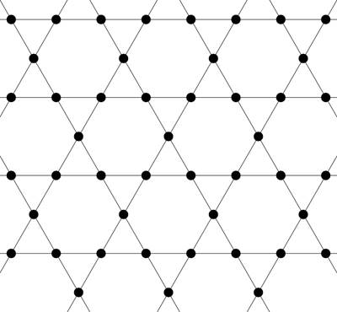
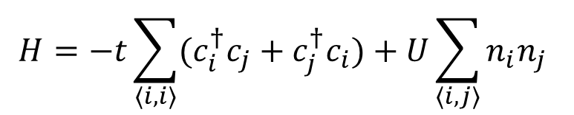
Kagome band structure
K
O’Brian et al., Phys. Rev. B 81, 235115 (2010)
H
t
K₃
Γ
M₃
M₁
K₂
M₂
K₁
Dirac points
VHS
flat band
Kagome Brillouin zone
$$H=−t\sum_{\left\langle i,i\right\rangle }{{(c}_{i}^{†}c_{j}}+c_{j}^{†}c_{i})+U\sum_{\left\langle i,j\right\rangle }{n_{i}n_{j}}$$

Slide 9
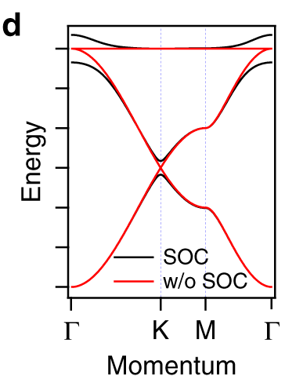
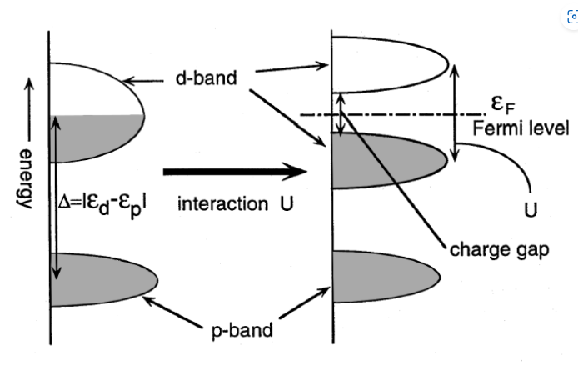
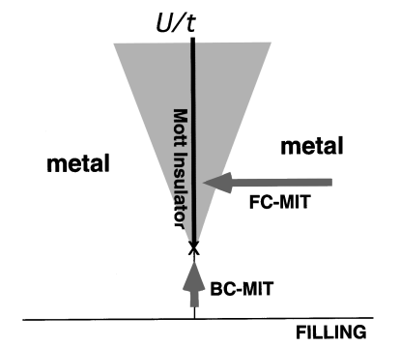
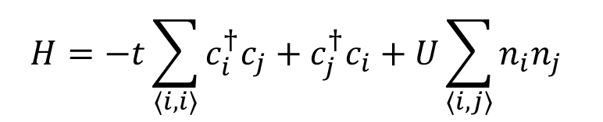

Two limits: Large and small U
Liu et al., Nature Comm. 11, 4002 (2020)
Imada et al., Reviews of Modern Physics, 70 (1998)
$$H=−t\sum_{\left\langle i,i\right\rangle }{c_{i}^{†}c_{j}}+c_{j}^{†}c_{i}+U\sum_{\left\langle i,j\right\rangle }{n_{i}n_{j}}$$
$$H=−J\sum_{\left\langle i,i\right\rangle }{S_{i}∙S_{j}}$$

Slide 10
Kagome insulators

Slide 11
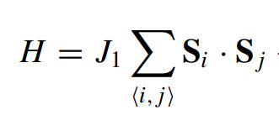
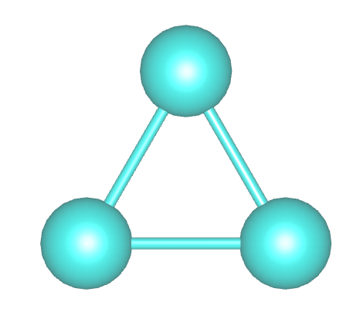
Magnetic frustration
Real space frustration of AF bonds: J>0
Three sublattice structures
  Triangular lattice + kagome lattice
  Heisenberg triangular lattice orders
  Kagome remains open frontier
  Maximally frustrated lattice in 2D
J
J
?
J
?
(Extensive degeneracy, unstable to fluctuations)
J
?
?
J
J
J
J
?
?
?
J

Slide 12


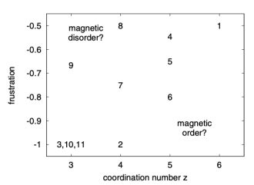

Magnetic frustration in two-dimensions
Crasto de Lima et al., Phys. Chem. Chem. Phys. (2019)
Richter and Kobe, J. Phys. C (1982) and Quantum Magnetism (Springer)
Assuming all equivalent bonds are AF
Only even sides polygons: unfrustrated
Lattices with only equivalent bonds versus those with inequivalent
Energy of classical Heisenberg AF and look at energy increase per bond: Triangular and kagome lattice
Strongest quantum fluctuations with largest m and lowest coordination

Slide 13
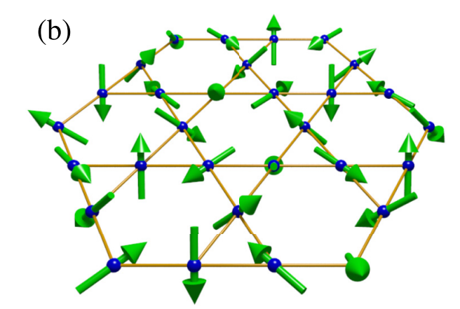
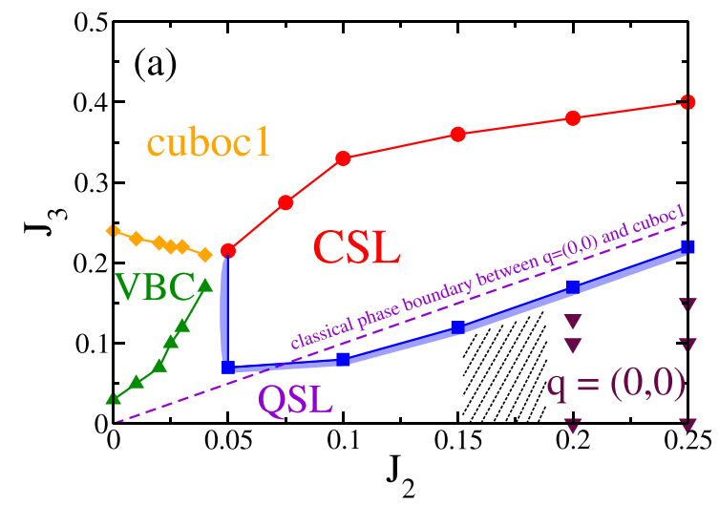
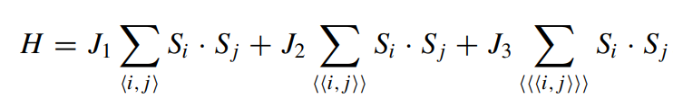
Frustrated magnetism in kagome lattices
Gong et al., Physical Review B 91, 075112 (2015)
Rich spectrum of intrinsically quantum disordered and noncoplanar magnetic ground states
Different flavors of spin liquids predicted

Slide 14
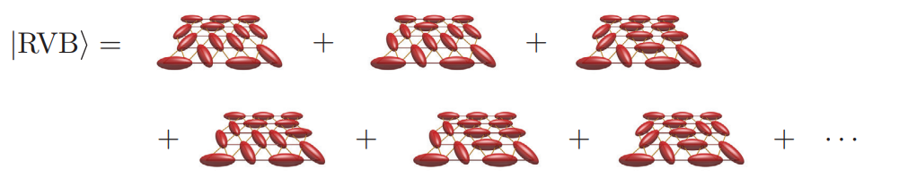
Quantum spin liquid states
Term introduced by Andersen (Mater. Res. Bull. 8 153 (1973))
Highly entangled states of many spins that occur in varying flavors
  Gapless and gapped QSLs
  Gapped QSLs: Topological order and emergent quasiparticles (anyons in 2D)
  Example: Spinon (S=1/2, charge 0 quasiparticle) created in pairs
Savary and Balents, Rep. Prog. Phys. 80 016502 (2017).

Slide 15
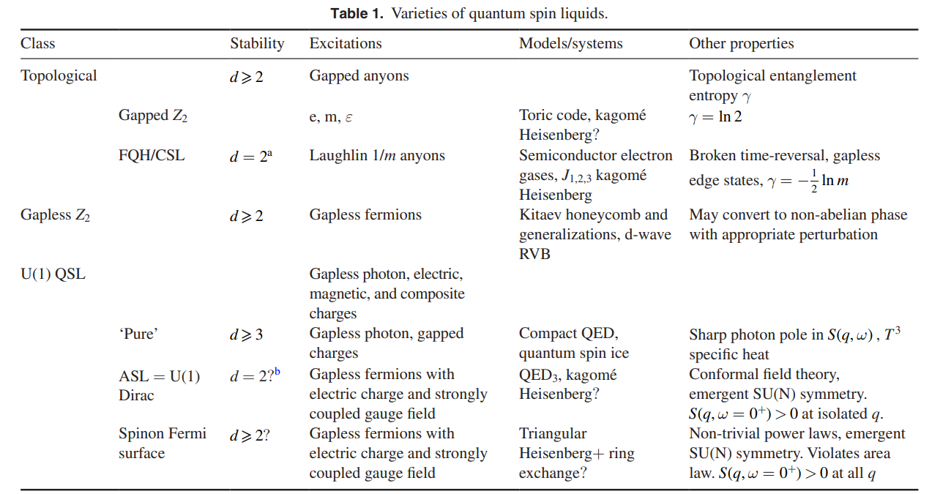
Quantum spin liquid states
Savary and Balents, Rep. Prog. Phys. 80 016502 (2017).

Slide 16
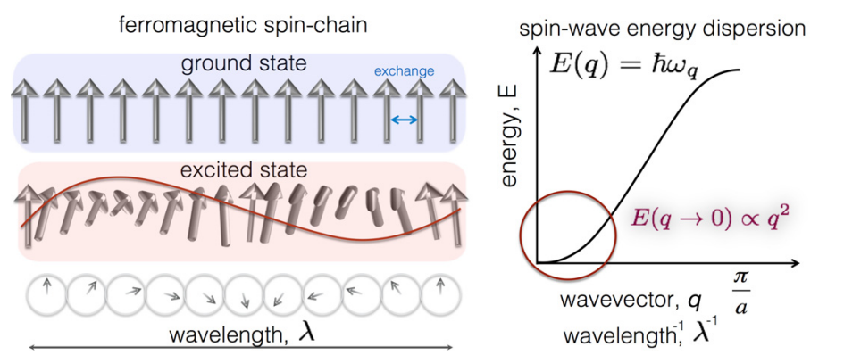
Unfrustrated magnetism in kagome lattices
Excitations of ordered state can have topogically nontrivial character
Magnons: Bosonic (ΔS=1) quasiparticles that form a band structure
Etz et al., J. Phys. : Condens. Matter 27, 243202 (2015).

Slide 17
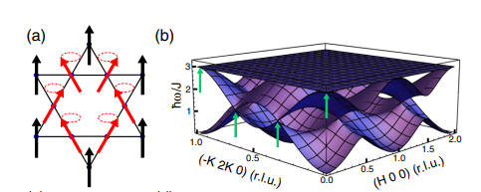
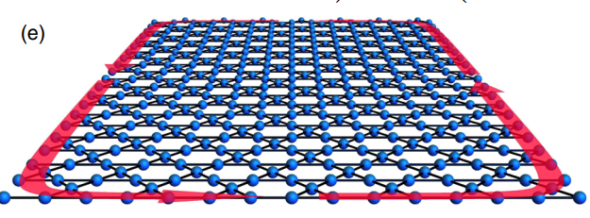
Unfrustrated magnetism in kagome lattices
Topological magnons in the spectrum of kagome ferromagnets
Three sublattice structure: three magnon bands
Dirac crossing and flat band
Antisymmetric exchange terms (DM interactions) can gap band touching
“Topological magnon insulators”
Chisnell et al., Phys. Rev. Lett. 115, 147201 (2015)

Slide 18
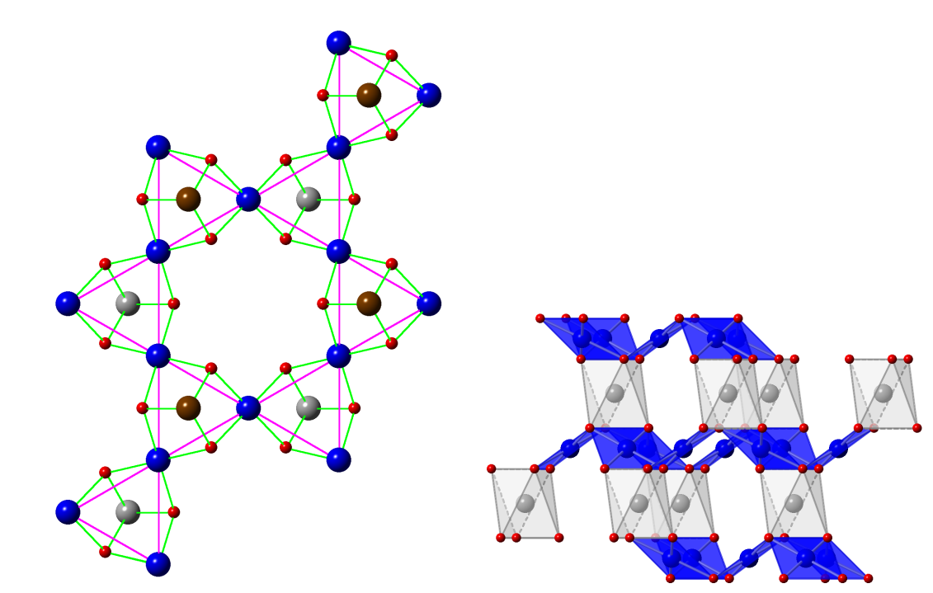
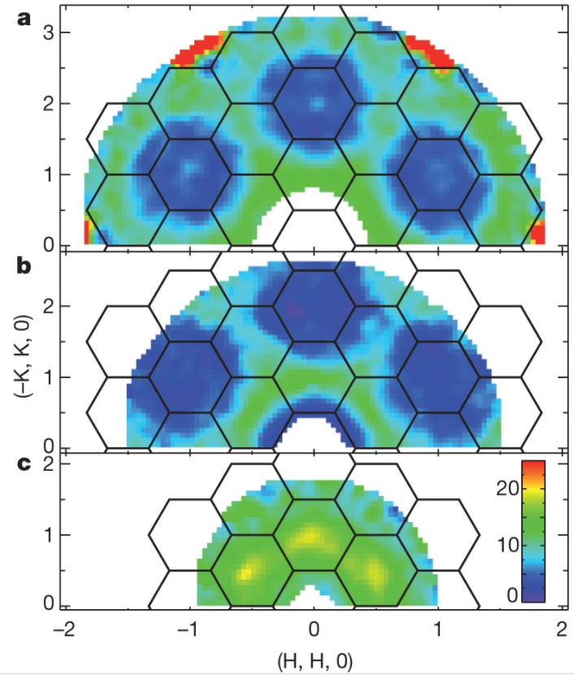
Materials examples of kagome magnets
Norman Rev. Mod. Phys. 88, 041002 (2016)
Han et al., Nature 492, 406 (2012)
ZnCu₃(OH)₆Cl₂
Kagome net of Cu²⁺ (S=1/2) moments
Fractionalized spin excitations
Quantum spin liquid candidate

Slide 19
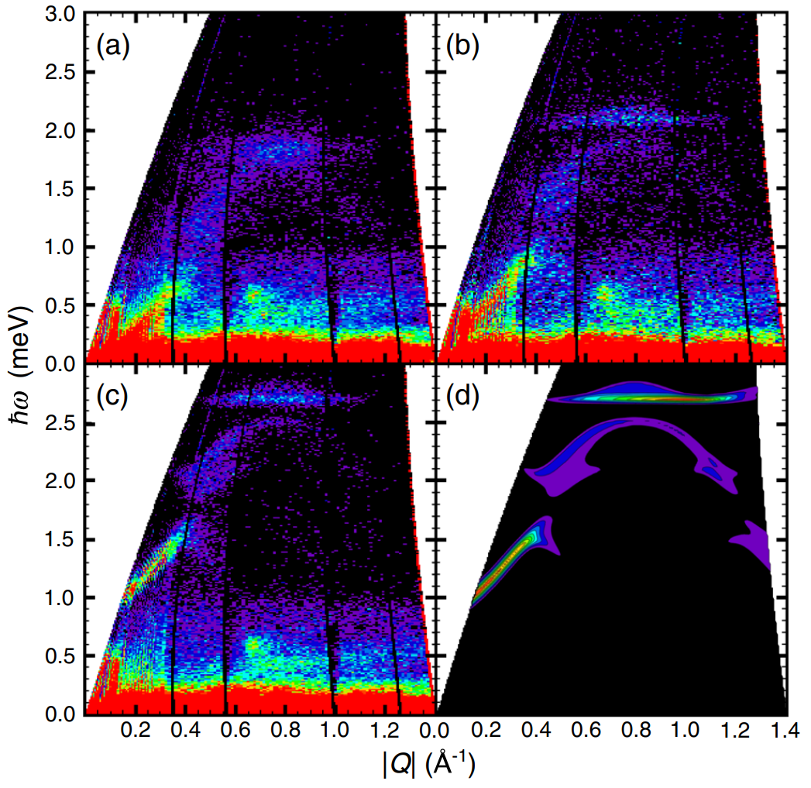
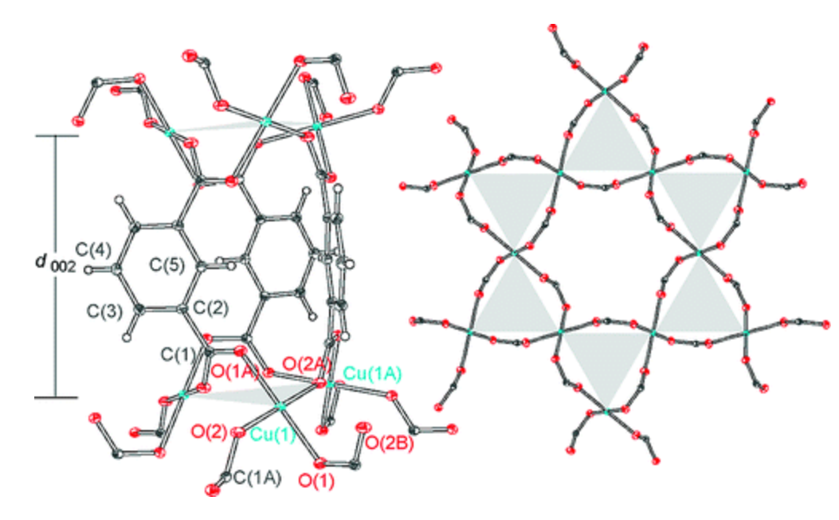
Materials examples of kagome magnets
Nytko et al. Journ. Am. Chem. Soc. 130, 2863 (2008)
Chisnell et al., Phys. Rev. Lett. 115, 147201 (2015)
Cu(1,3-bdc) (1,3-bdc=1,3-benzenedicarboxylate)
Kagome net of Cu²⁺ (S=1/2) moments
Flat magnon band
Gap enhanced
by out-of-plane B-field

Slide 20
Kagome metals

Slide 21
Different features at different band fillings
Liu et al., Nature Comm. 11, 4002 (2020)
2/3 filling
5/12 filling
1/3 filling
3/12 filling
Dirac point
Two saddle points
Flat band

Slide 22
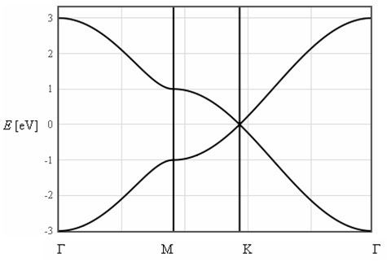
One way to visualize kagome band structure
Poincaré-Hopf theorem: Guaranteed 2 saddle points in two dimensional BZ
Bipartite honeycomb lattice

Slide 23
One way to visualize kagome band structure
Poincaré-Hopf theorem: Guaranteed 2 saddle points in two dimensional BZ
Connect midpoints to form a “line graph”

Slide 24
One way to visualize kagome band structure
Connection via line graphs: A Mielke J. Phys. A: Math. Gen. 24, ﻿73 (1991).
Inherit original bands + flat band
Populate sites at new vertices

Slide 25
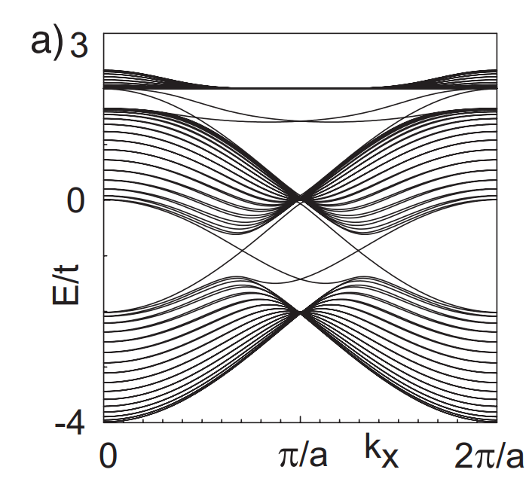
Kagome lattice near 1/3 filling
Spin-orbit coupling drives Dirac point to gap
Forms strong topological insulator
Quantum spin Hall state
  Bernevig and Zhang , Phys. Rev. Lett. 96, 106802 (2006). Kane and E. J. Mele , Phys. Rev. Lett. 95, 226801 (2005).
Liu et al., Nature Comm. 11, 4002 (2020)
1/3 filling
Protected
Edge States
Guo and Franz, Physical Review B 80, 113102 (2009)

Slide 26
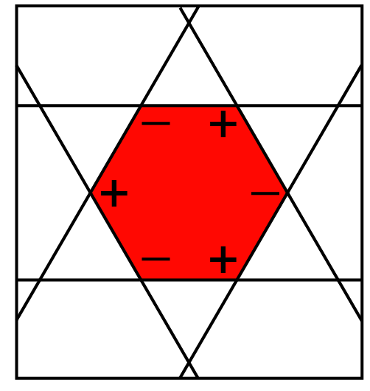
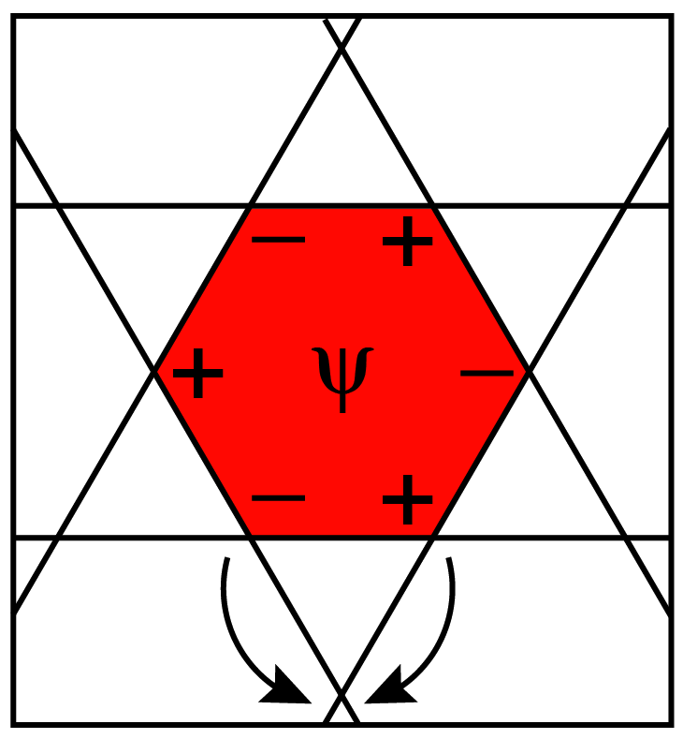
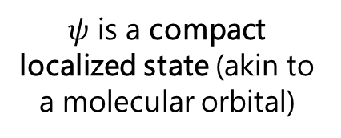
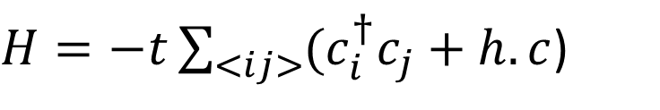
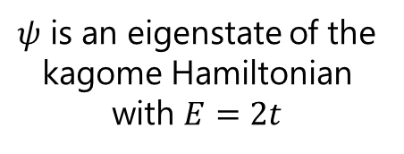


Kagome lattice near 2/3 filling
Graphic courtesy of Riccardo Comin
$H=−t\sum_{<ij>}{(c_{i}^{†}c_{j}}+h.c$)
2/3 filling
$$ψ$$
$$H$$
$ψ$ is an eigenstate of the kagome Hamiltonian with $E=2t$
$ψ$ is a compact localized state (akin to a molecular orbital)
Quantum interference
Quantum Interference results from kinetic frustration
Localized state results

Slide 27
Effects at flat band filling
Interactions, in this case, ferromagnetic can generate QAH state
Interactions, in general, are nonpertubative
  Rich spectrum of many-body states

Slide 28
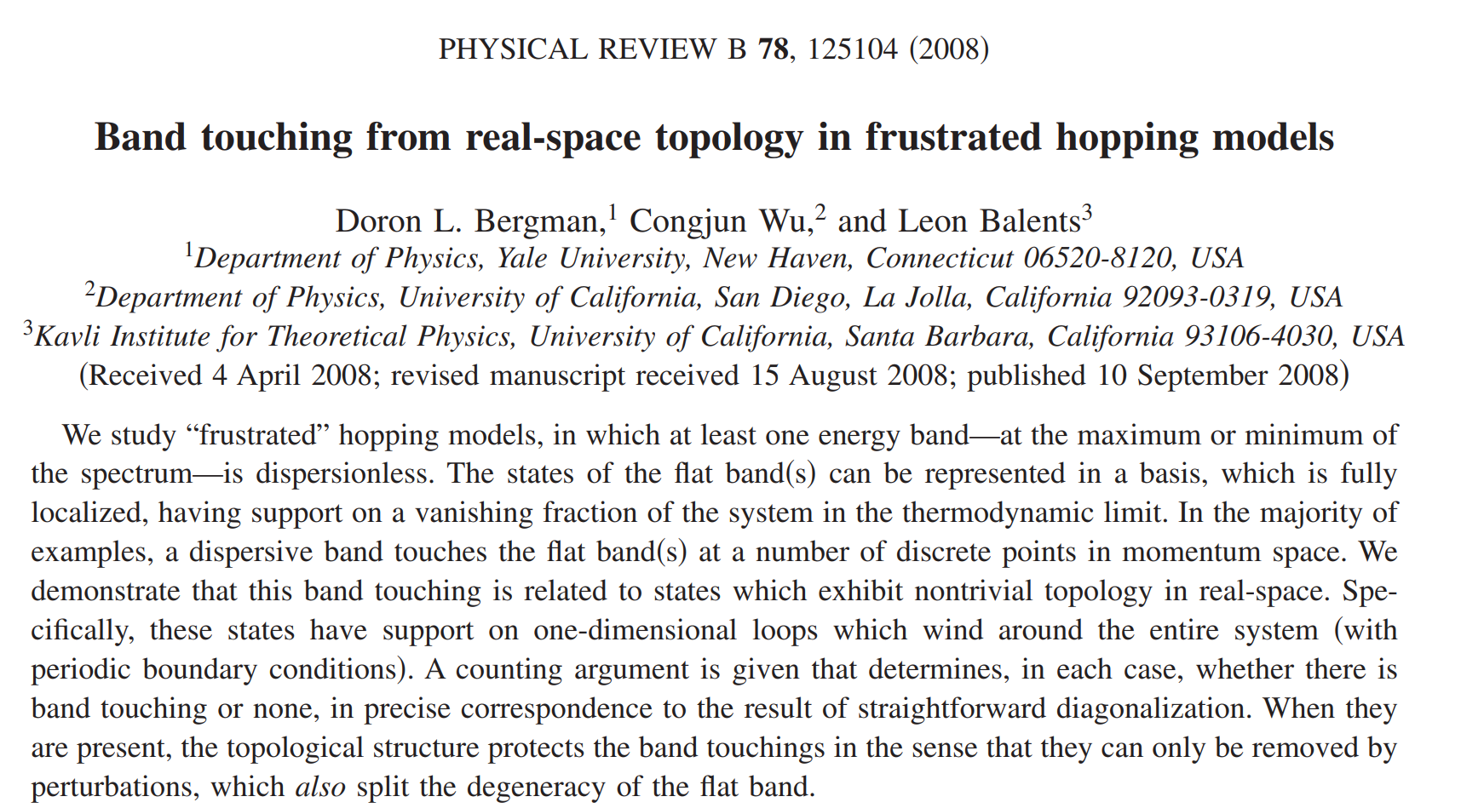
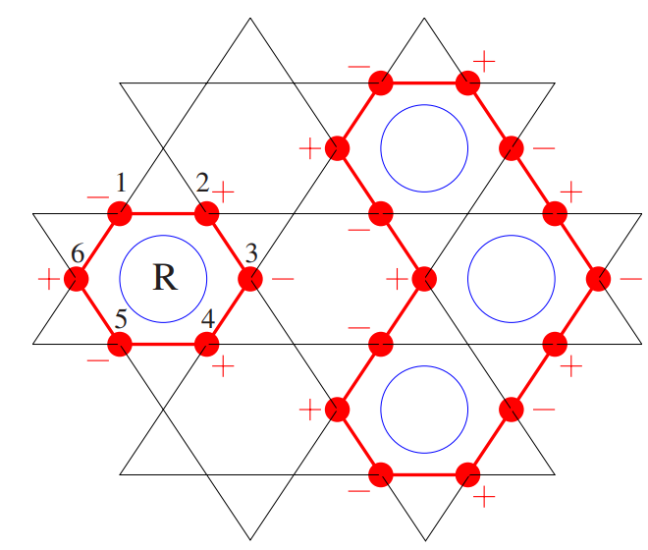
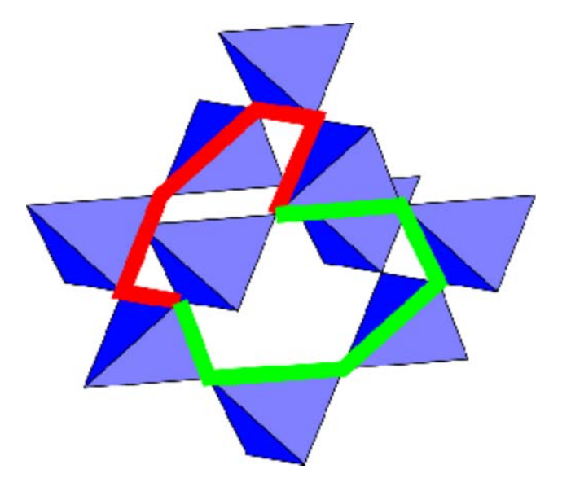
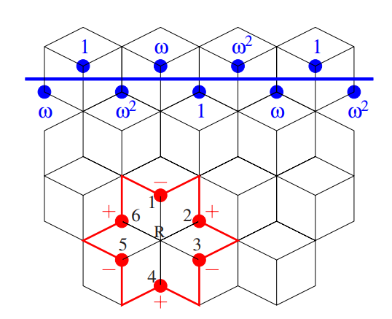
Flat bands from frustrated hopping
Kagome
Pyrochlore
Dice
+ others…

Slide 29
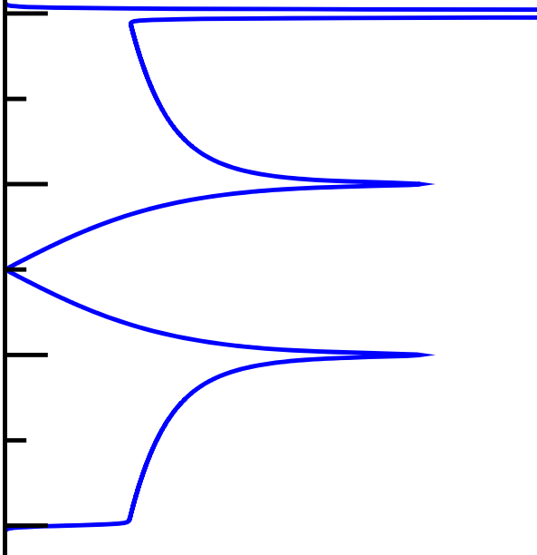
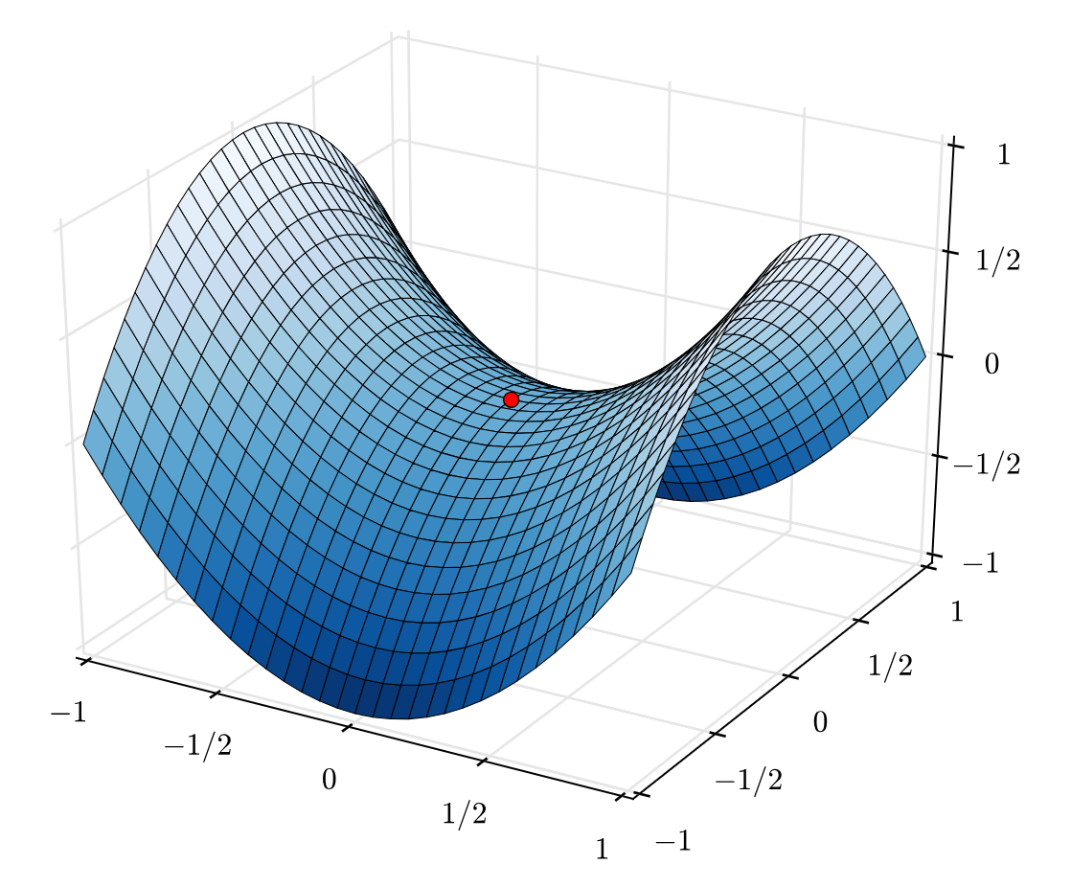
Kagome lattice at Van Hove filling
LDOS
Logarithmic divergent in the local density of states
Léon Van Hove, Phys. Rev. 89, 1189 (1953)
Nesting between VHS can promote electronic instabilities
Energy
5/12 filling
3/12 filling
k_{H}
k_{K}

Slide 30
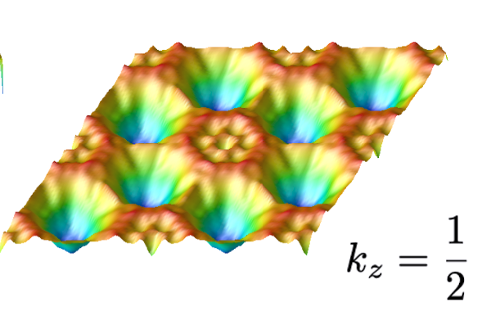
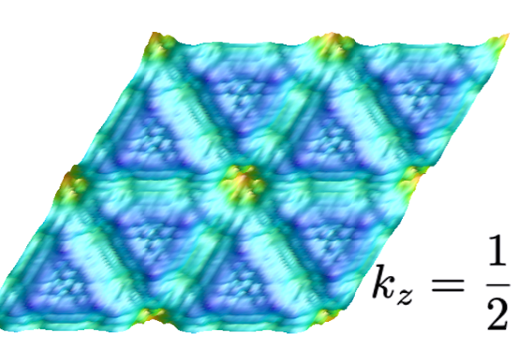
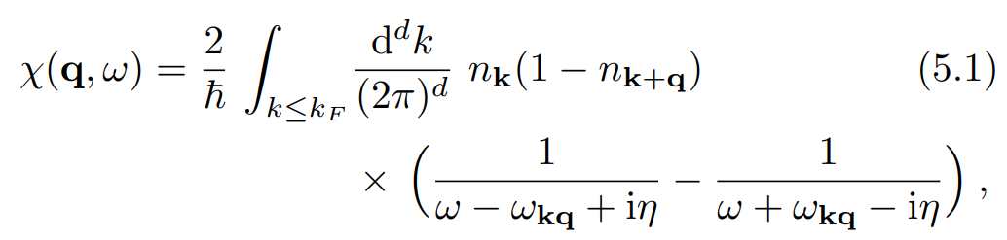


What can happen when near VH filling?
Johannes and Mazin, Phys. Rev. B 77, 165135 (2008).
Kabouvand et al, Appl. Phys. Lett. 120, 111901 (2022)
$$χ^{′}′(q,E)$$
$$χ^{′}(q,E)$$
M₃
M₁
M₂
“Nesting” of electronic states can occur at well-defined wave vector q
Creates peaks in χ′′(q) and χ′(q) of Lindhard response function
Promotes instabilities, electronic order

Slide 31
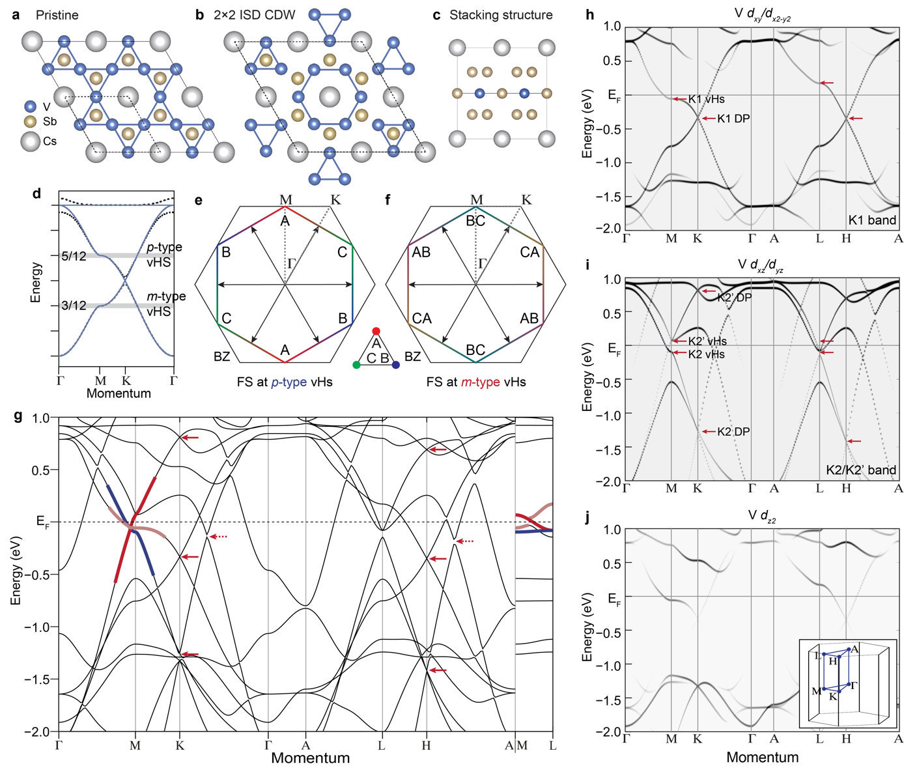
What can happen when near VH filling?
Mingu Kang et al., Nat. Phys. 18, 301 (2022)
Two flavors of VHS in kagome band structure:
“Pure” VHS with wave functions from a single sublattice
“Mixed” VHS with wave functions from two separate sublattices

Slide 32
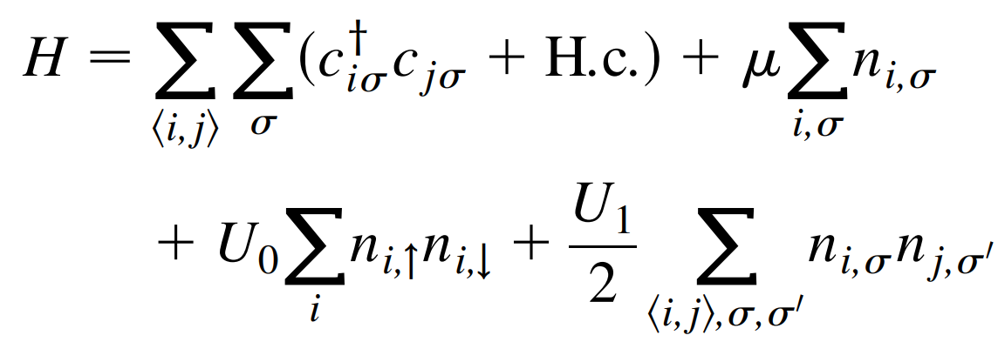
Kagome lattice Hubbard model
Kiesel et al., Phys. Rev. Lett. 110, 126405 (2013).
p-type VHs: U₀ diminished/vanishes
“Sublattice interference”
U₁ at weak coupling can promote attractive NN site interactions
Unconventional superconductivity predicted to form

Slide 33
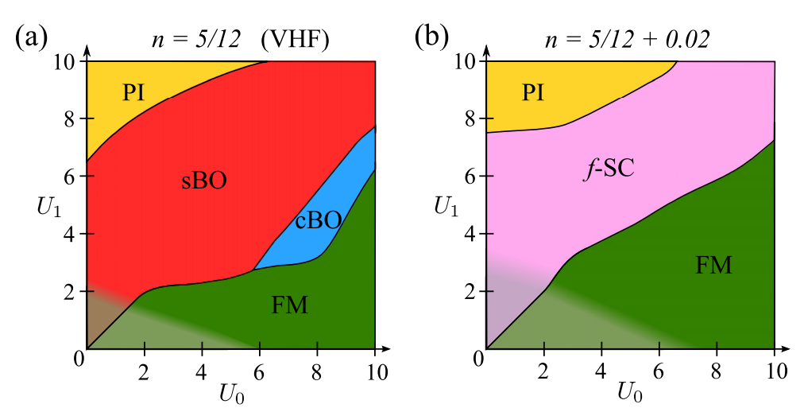
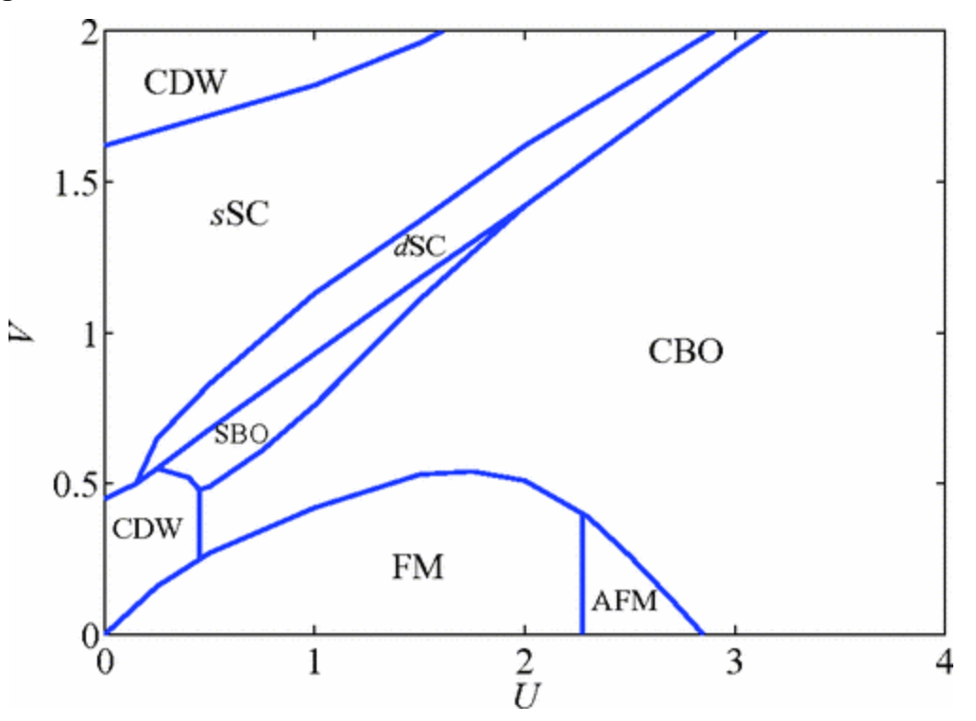
Electronic instabilities at Van Hove filling
Kiesel et al., Phys. Rev. Lett. 110, 126405 (2013).
Variety of interaction-driven instabilities predicted
  Charge density wave order
  Bond density wave states
  Unconventional superconductivity
Sublattice interference amplifies influence of U₁ and extended exchange
Wang et al., Phys. Rev. B 87, 115135 (2013).

Slide 34
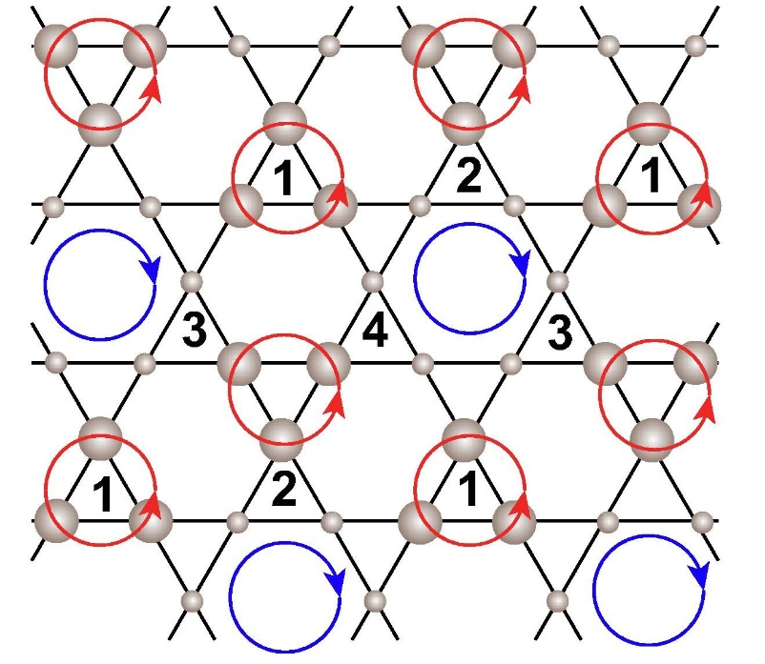



Electronic instabilities at Van Hove filling
Feng et al., Science Bulletin 66, 30 (2021)
Li et al., Phys. Rev. Lett 132, 146501 (2024)
Haldane et al., Phys. Rev. Lett. 61, 2015 (1988)
Appreciable NNN interaction
Two coupled VHS + NN interactions
C M Varma J. Phys.: Condens. Matter 26 505701 (2014)
Chiral flux states
  Orbital antiferromagnets
Primary and secondary orders
  Real and “imaginary” CDW states

Slide 35



How do we find the “right” kagome materials?
Challenge: Dealing with how isolated a kagome net is within a three-dimensional solid
Nearest neighbor distance should be kagome net bonding
Weak bonding in other directions
d_{K}
d_{NN}

Slide 36





Kagome networks in isolated substructures
Kagome networks isolated
Kagome networks not isolated

Slide 37



Recent materials survey of kagome compounds
Jovanic and Schoop, J. Am. Chem. Soc. 144, 10978 (2022).
d_{NN}
Tolerance factor: t = d_{k}/d_{NN}
d_{K}

Slide 38

Also: survey for flat band materials
Regnault et al., Nature 603, 824 (2022).
https://www.topologicalquantumchemistry.com/flatbands/bestflatband.html
https://icsd.fiz-karlsruhe.de/

Slide 39
Conclusions
Kagome lattices are “target rich” materials platforms for hosting both correlated and topologically nontrivial electronic states
Insulators are near ideal hosts for highly frustrated magnetic order
Metals at various band fillings are predicted to host a variety of unconventional electronic states
Most importantly: Kagome lattices are not uncommon in nature, allows for large range of chemical tunability likely needed to realize/test predicted states

