Slide 1



Topological Matter School
August 19th, 2024
Unconventional Electronic States in Kagome metals, Material Case Studies: Lecture 2
Stephen D. Wilson
Professor, Materials Department
University of California, Santa Barbara

Slide 2
Outline
Flatband filling materials examples
  Correlation effects, magnetic order
Dirac filling materials examples
  Large AHE, strong Berry curvature
Van Hove Filling materials examples
  Charge density wave order
  Superconductivity
Interfacing kagome nets with other active layers

Slide 3
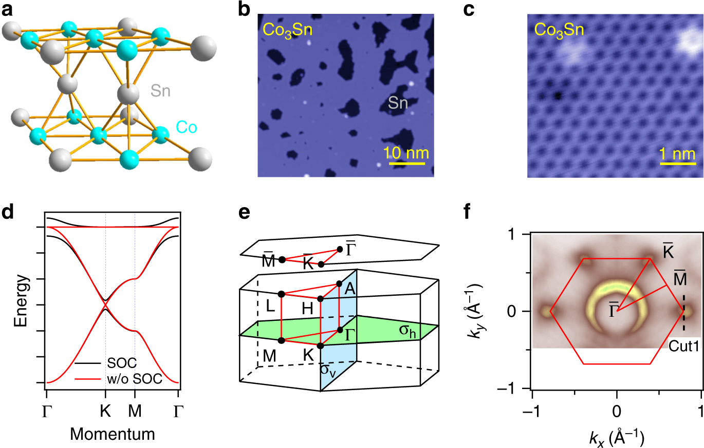
Different features at different band fillings
Liu et al., Nature Comm. 11, 4002 (2020)
2/3 filling
5/12 filling
1/3 filling
3/12 filling
Dirac point
Two saddle points
Flat band

Slide 4
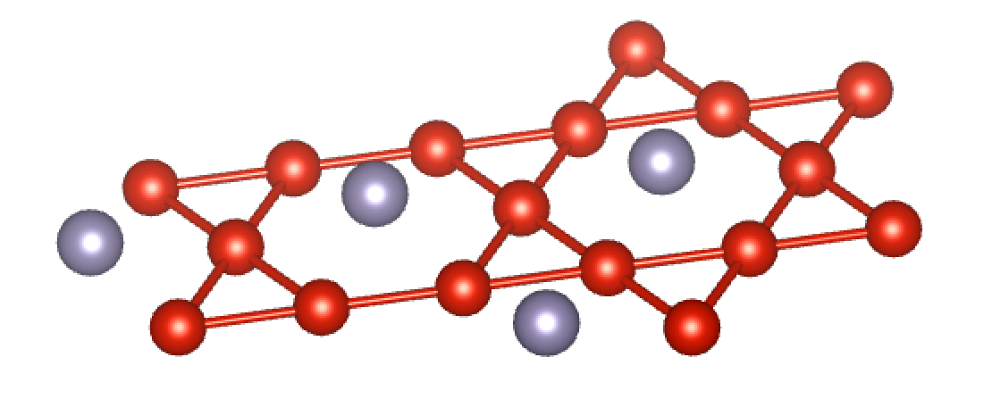
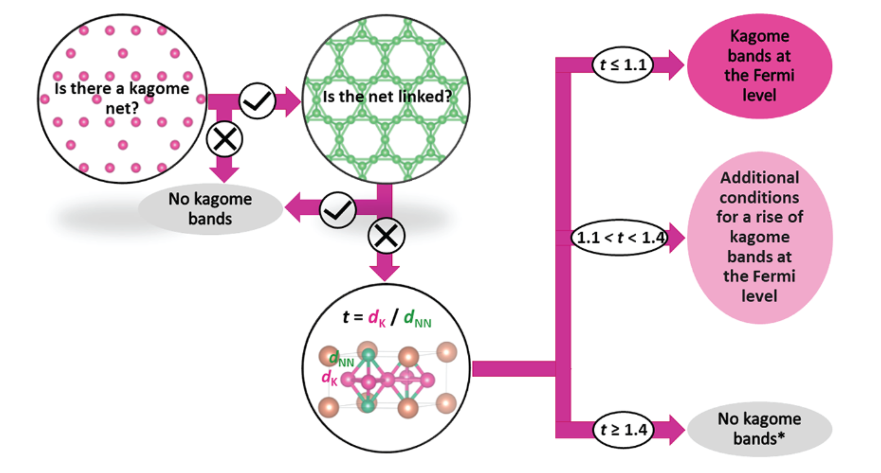
Recent materials survey of kagome compounds
Jovanic and Schoop, J. Am. Chem. Soc. 144, 10978 (2022).
d_{NN}
Tolerance factor: t = d_{k}/d_{NN}
d_{K}
Nearest neighbor distance should be kagome net bonding
Weak bonding in other directions
Chemically two-dimensional a bonus
Be mindful of multiple orbitals, multiple kagome sites

Slide 5
Kagome metals near flatband fillings

Slide 6
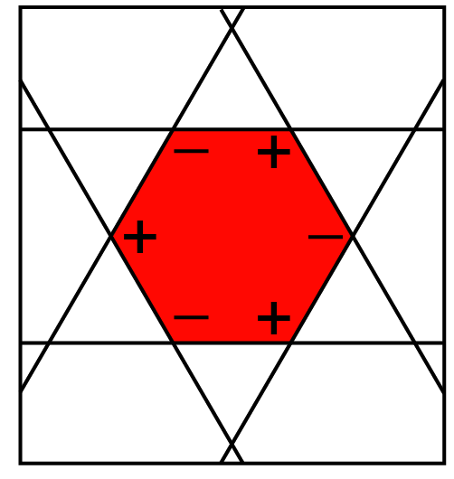
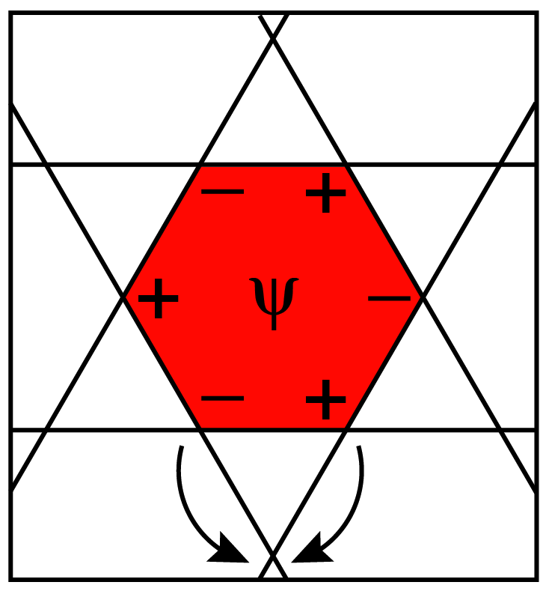
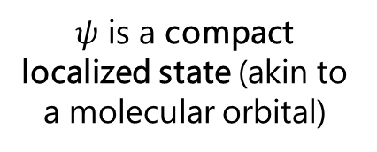
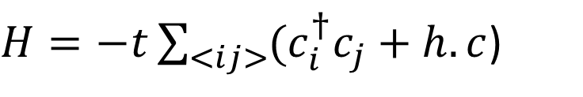
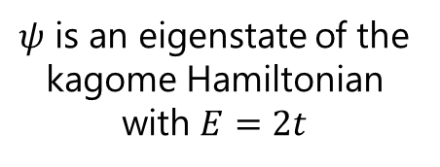


Kagome lattice near 2/3 filling
Graphic courtesy of Riccardo Comin
$H=−t\sum_{<ij>}{(c_{i}^{†}c_{j}}+h.c$)
2/3 filling
$$ψ$$
$$H$$
$ψ$ is an eigenstate of the kagome Hamiltonian with $E=2t$
$ψ$ is a compact localized state (akin to a molecular orbital)
Quantum interference
Quantum Interference results from kinetic frustration
Localized state results

Slide 7
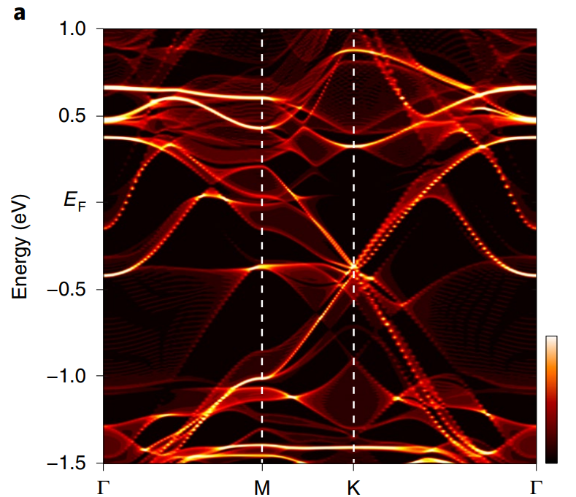
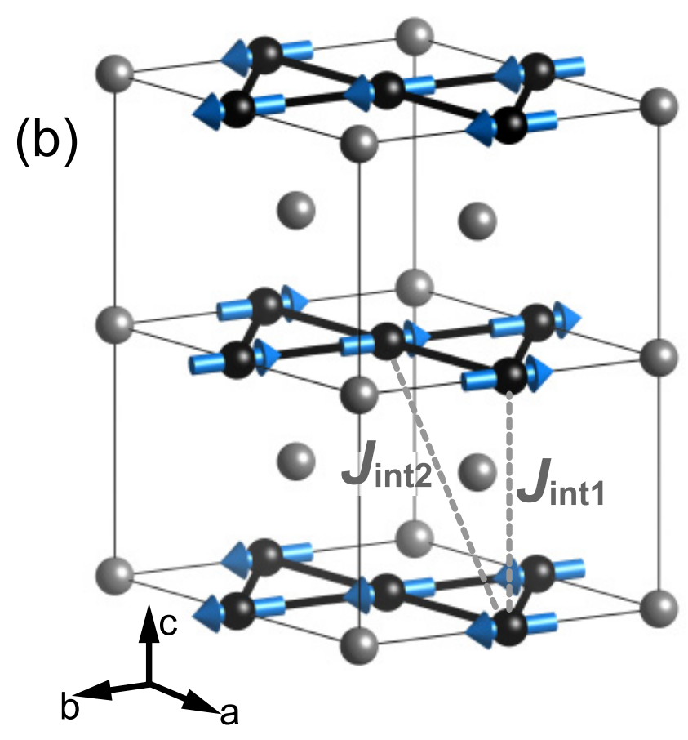
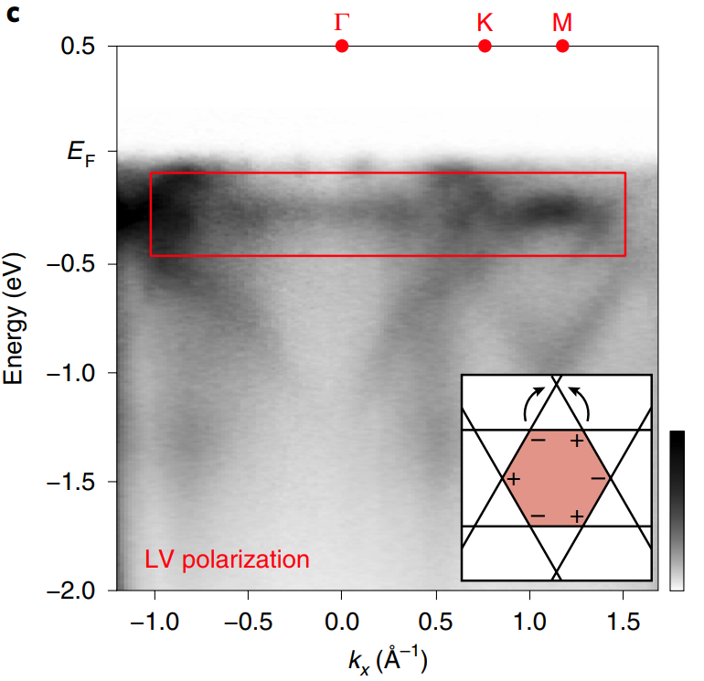
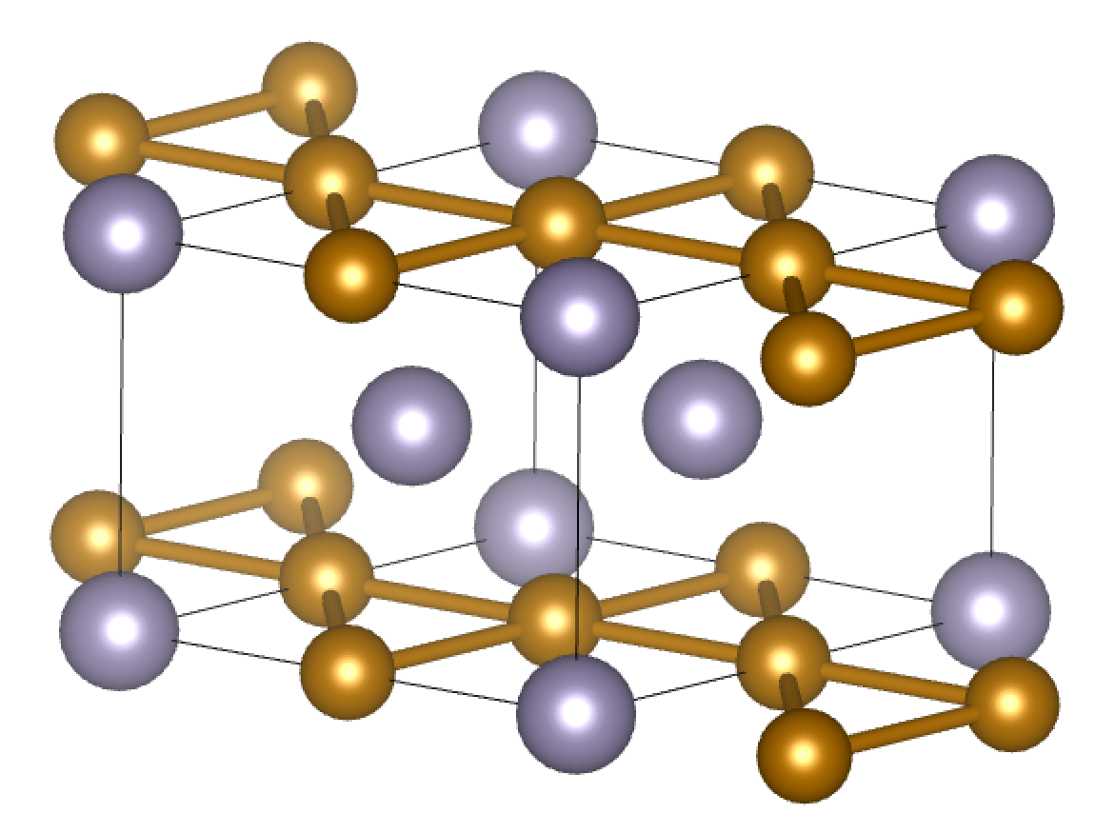
Material example 2: FeSn
Kang et al., Nature Materials 19 , 163 (2020).
Do et al., Physical Review B 105, L180403 (2022)
AF order, unexpected flatband near E_{F}

Slide 8
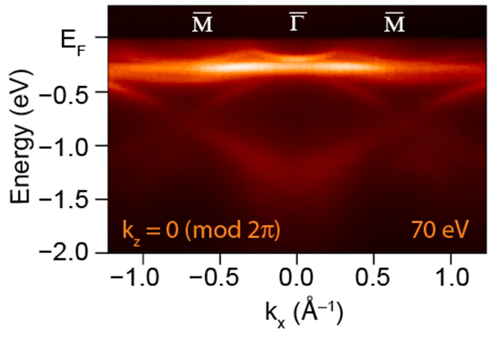
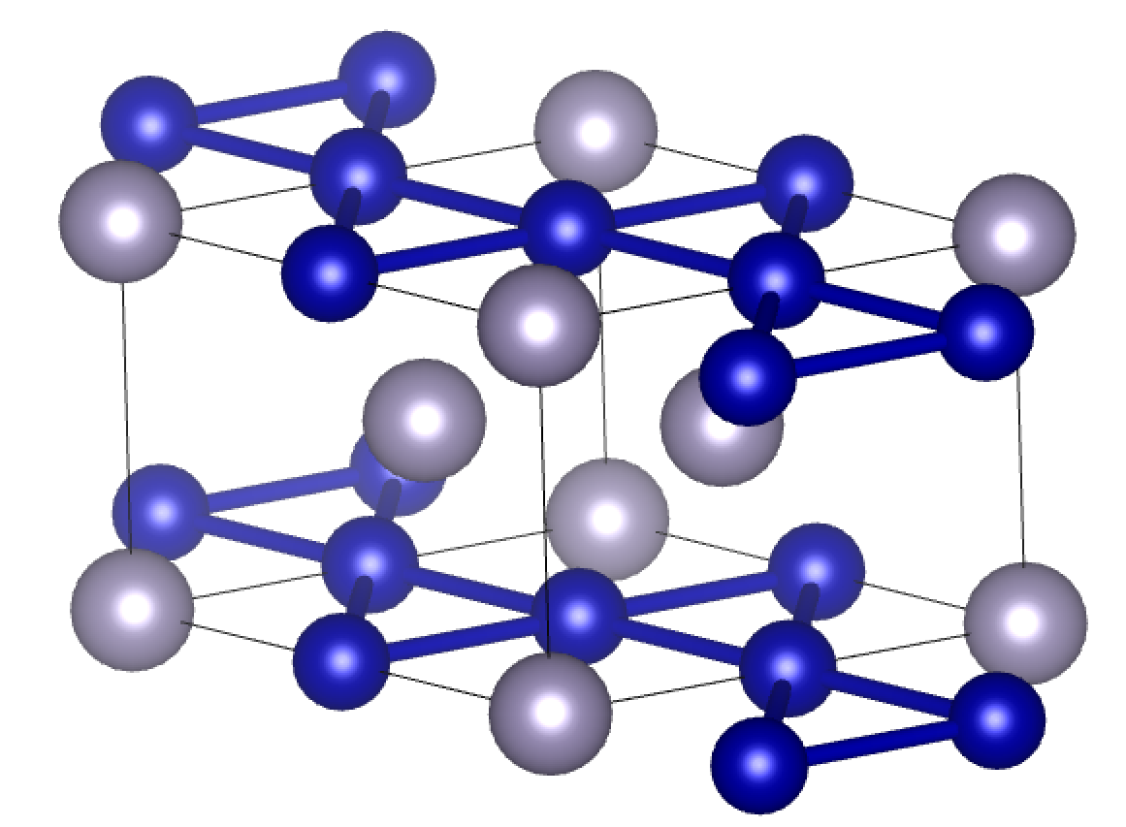
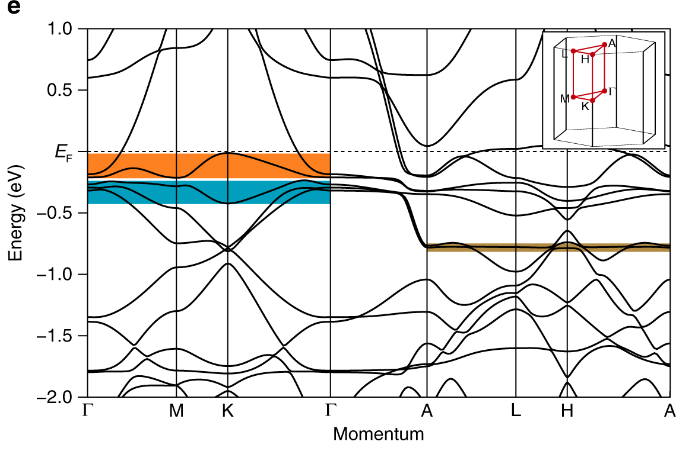
Material example 1: CoSn
Kang, Fang, …, JGC, RC, Nature Comm. 11, 4004 (2020)
Flat band at ~ 270 meV binding energy
Flat band acquires dispersion near the K point (likely due to NNN hopping)

Slide 9
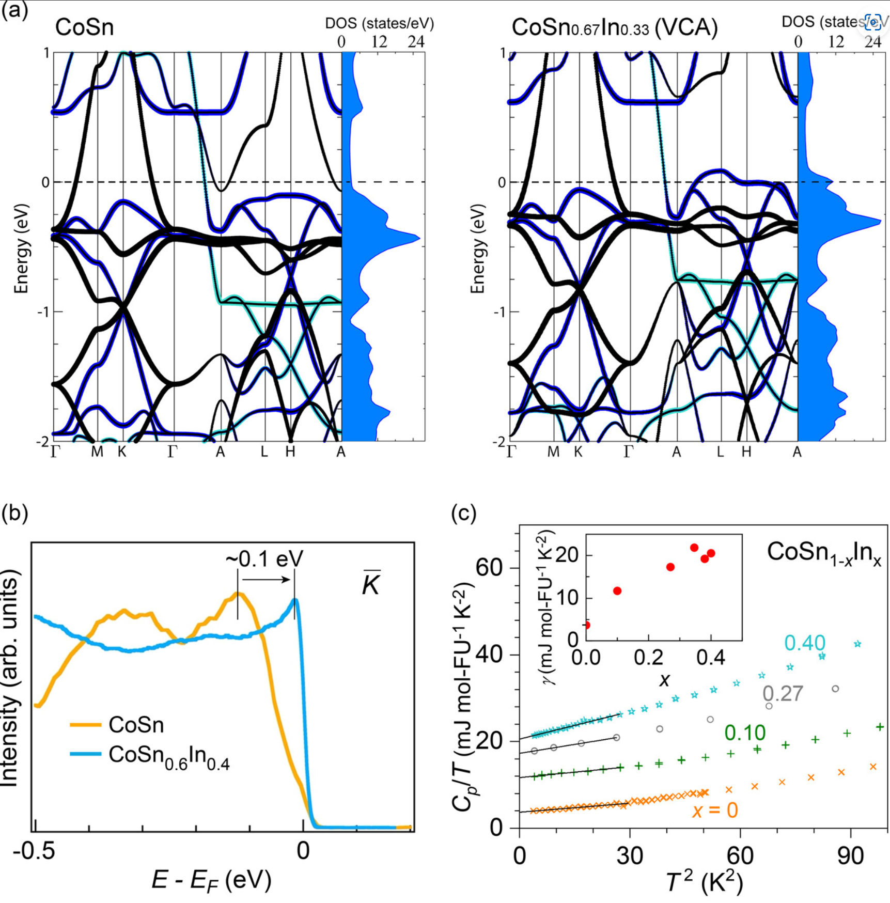
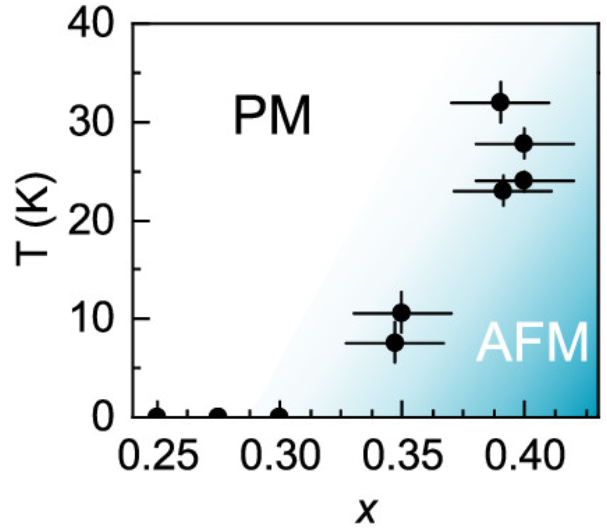
Tuning flatband toward E_{F}
Sales et al., Chem. Mat. 34, 7069 (2022).
Hole-doping sweeps E_{F} through flatband
AF order forms

Slide 10
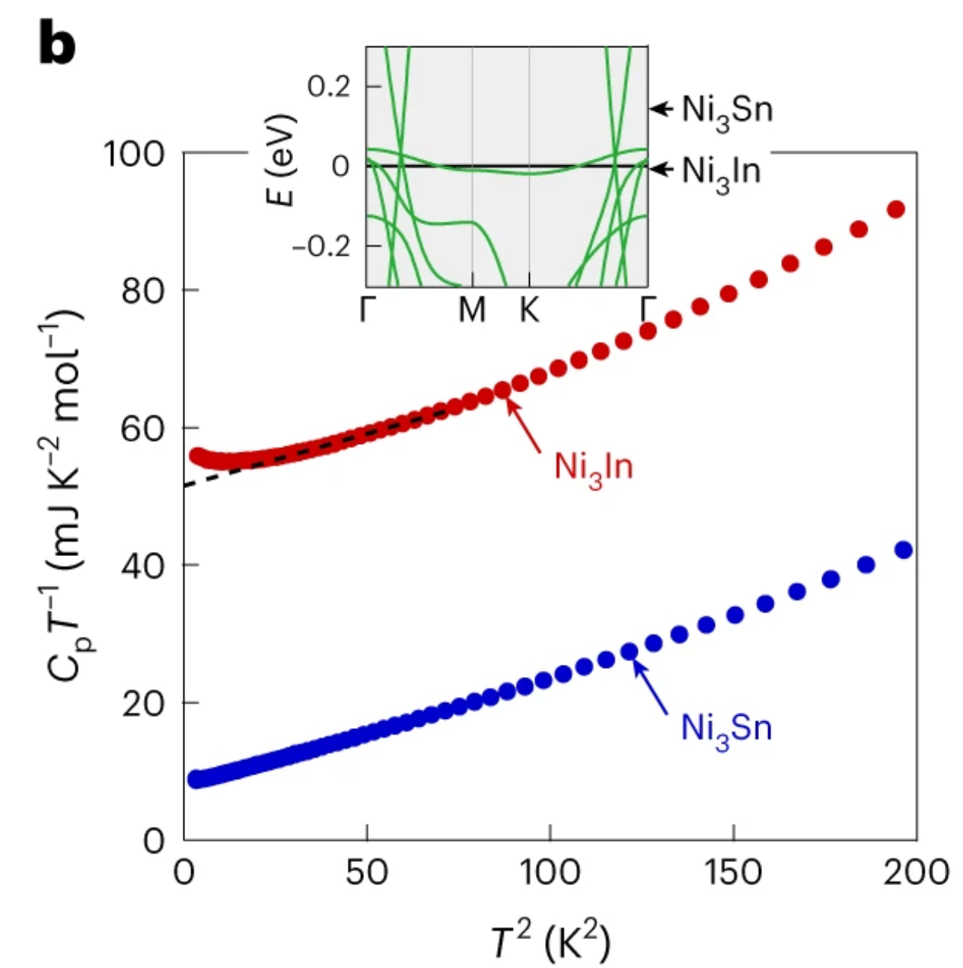
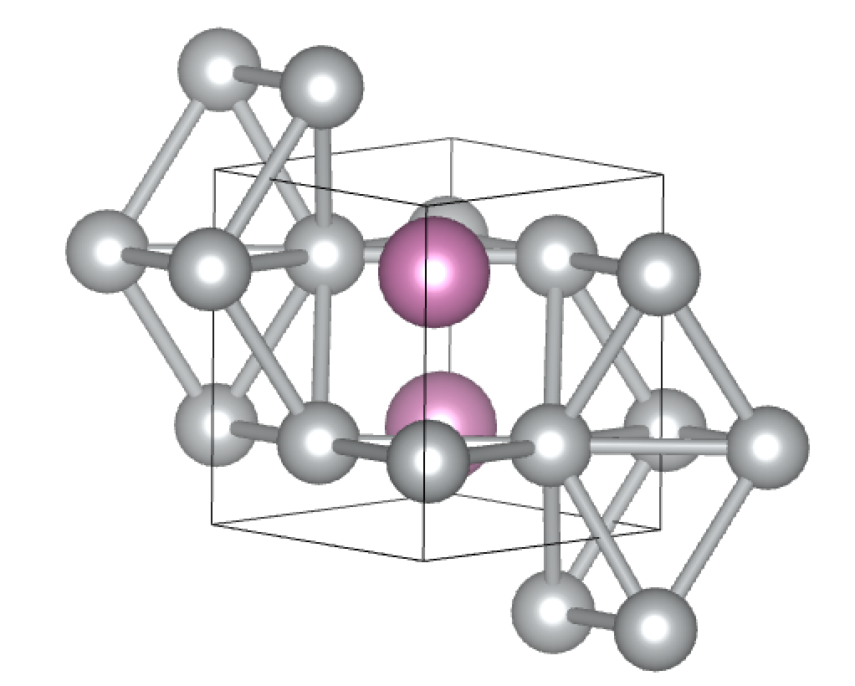
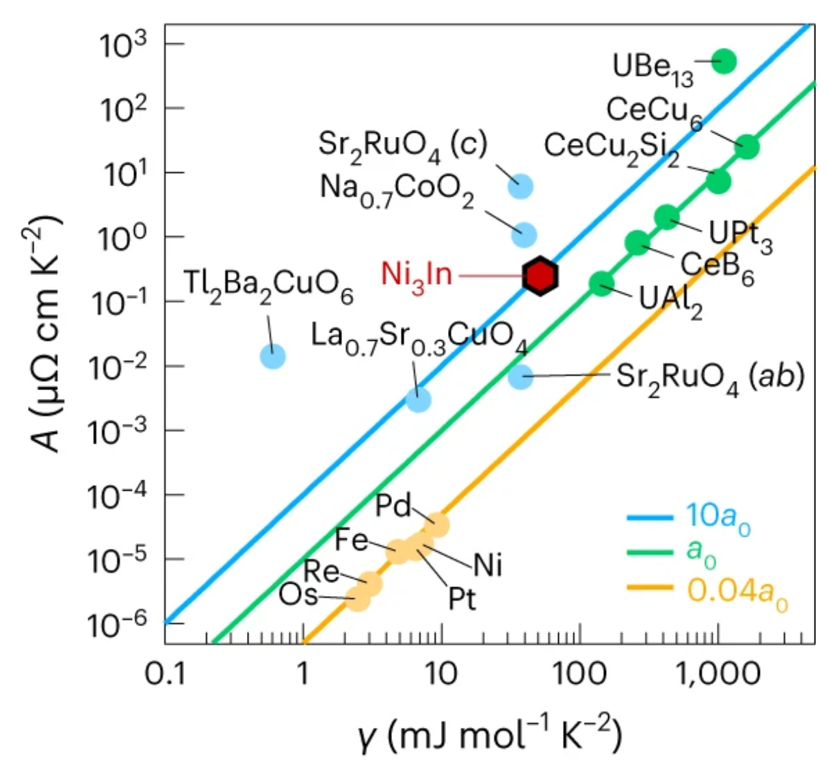
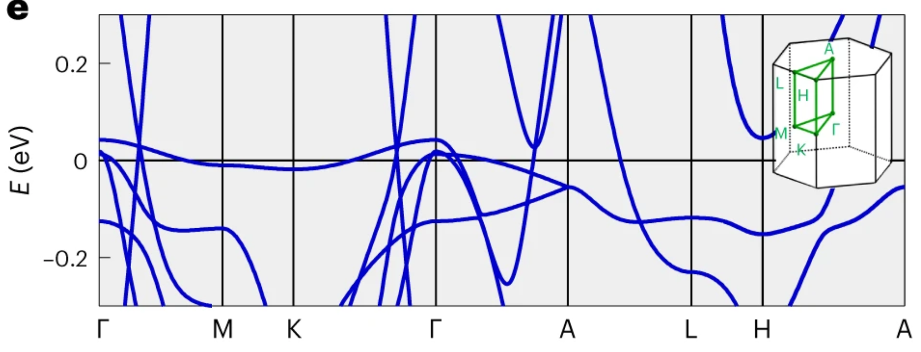
Material example 3: Ni₃In
Ye et al., Nature Physics 20, 610–(2024).
Flatband crossing E_{F}
Signatures of heavy Fermion behavior/electronic correlations

Slide 11
Kagome metals with gapped Dirac points

Slide 12
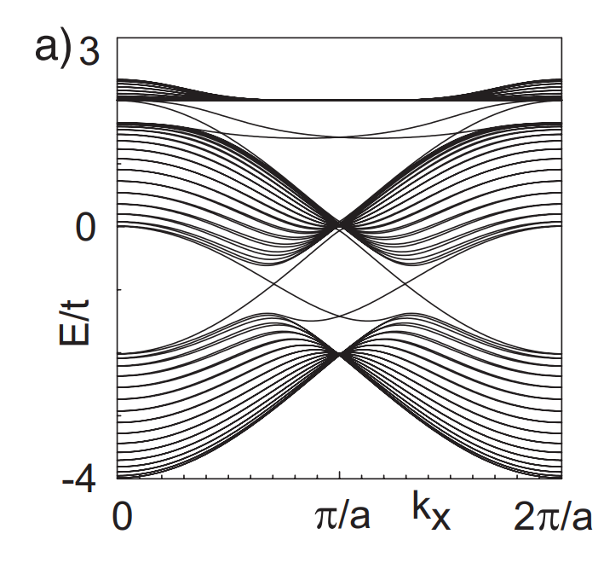
Kagome lattice near 1/3 filling
Spin-orbit coupling drives Dirac point to gap
Forms strong topological insulator
Quantum spin Hall state
  Bernevig and Zhang , Phys. Rev. Lett. 96, 106802 (2006). Kane and E. J. Mele , Phys. Rev. Lett. 95, 226801 (2005).
Liu et al., Nature Comm. 11, 4002 (2020)
1/3 filling
Protected
Edge States
Guo and Franz, Physical Review B 80, 113102 (2009)

Slide 13
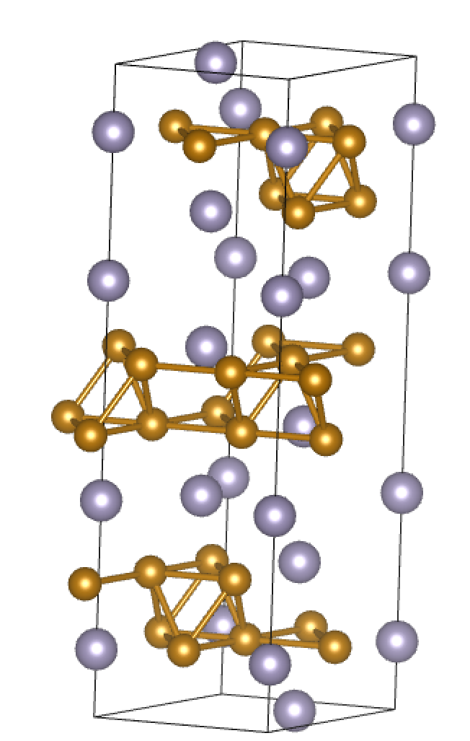
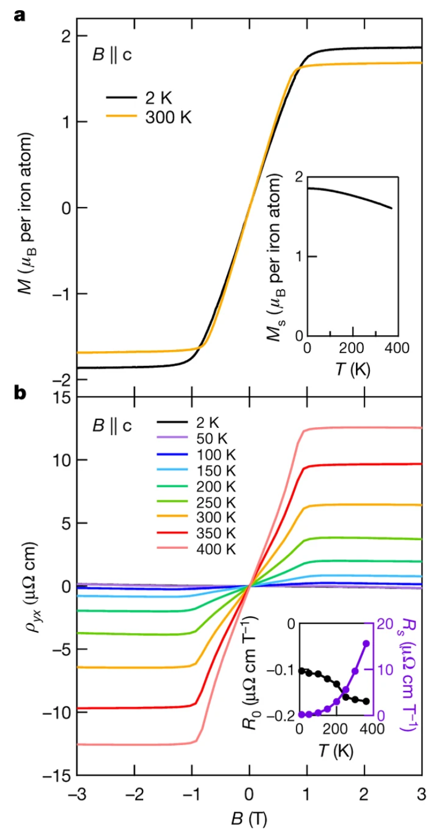
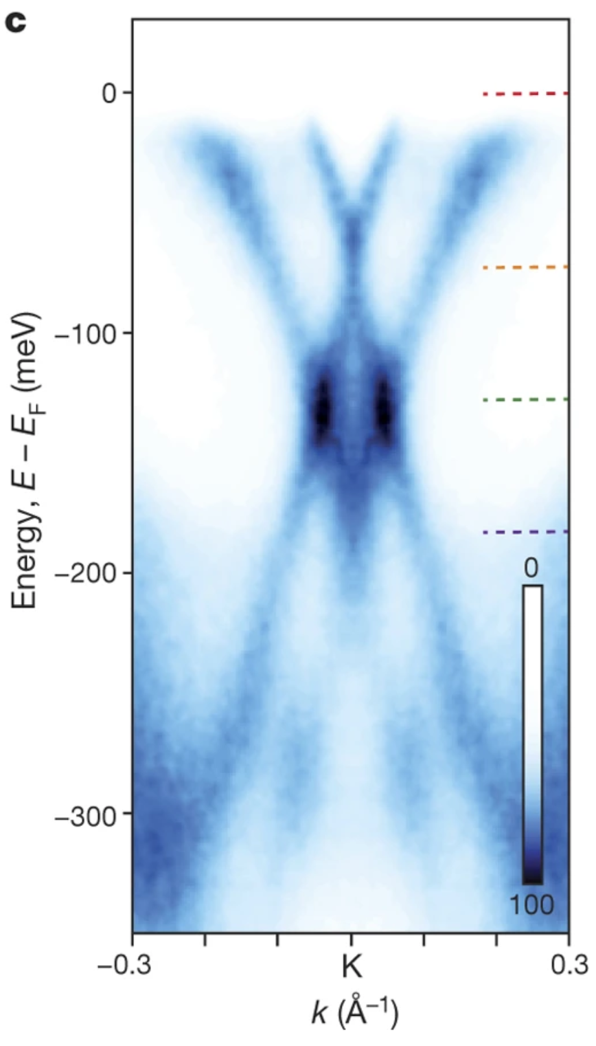
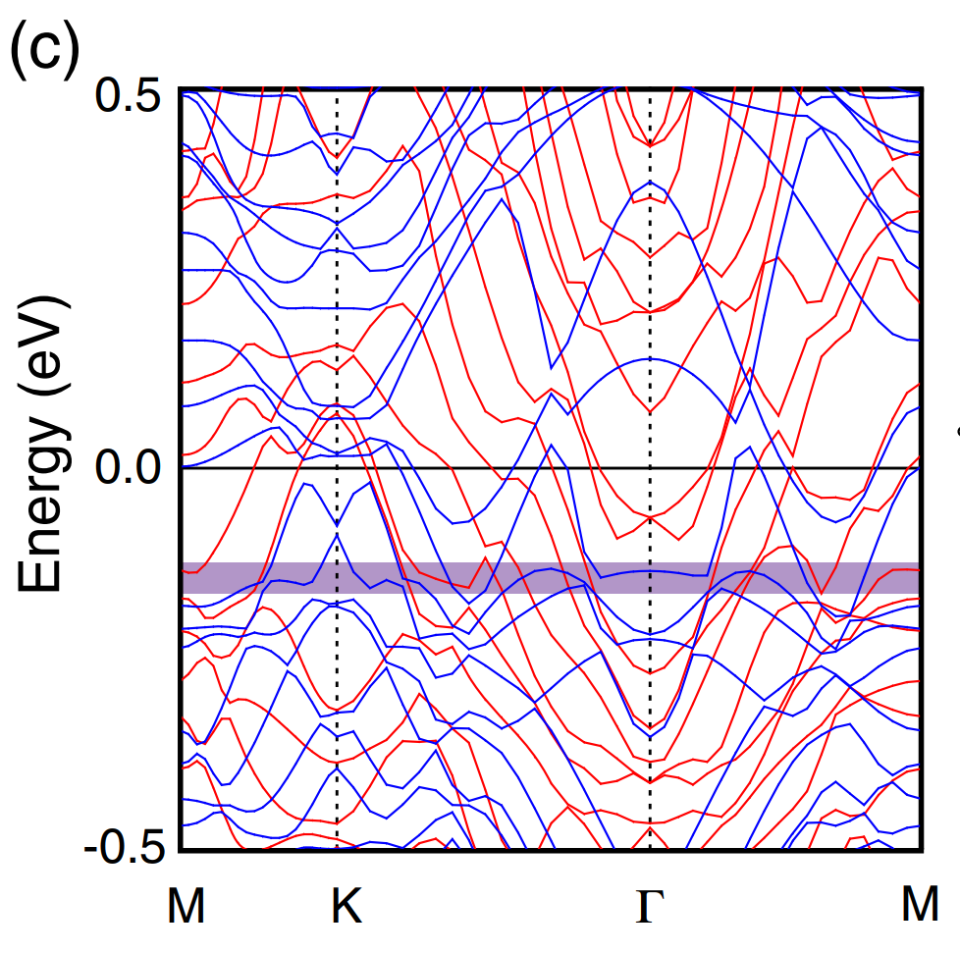
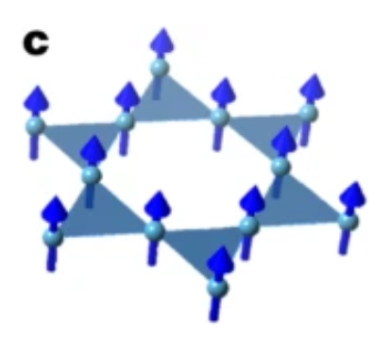
Material example 1: Fe₃Sn₂ variant
Lin et al., Phys. Rev. Lett. 121, 096401 (2018).
Ye et al., Nature 555, 638 (2018).
“Bilayer kagome structure”
Some features of kagome band structure preserved
Ferromagnetic order gaps Dirac crossings
Large anomalous Hall effect
AHE first noted by:
T Kida et al J. Phys.: Condens. Matter 23, 112205 (2011)

Slide 14
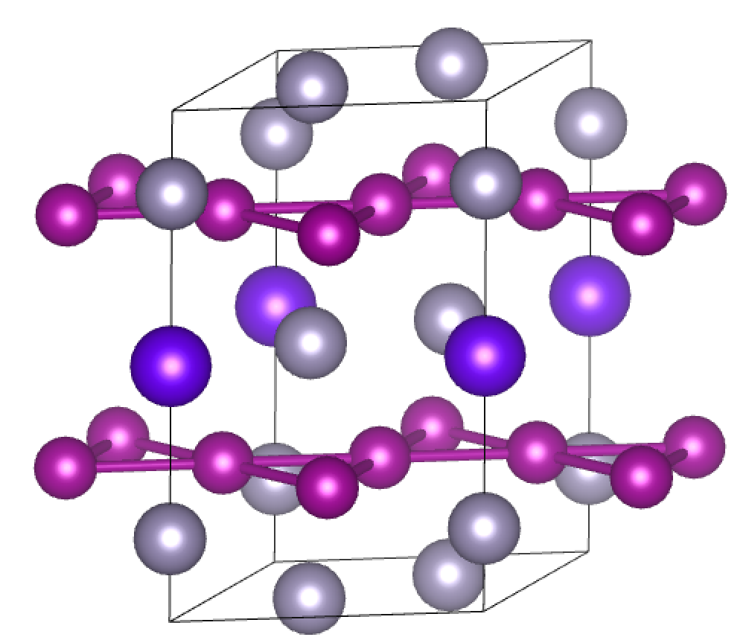
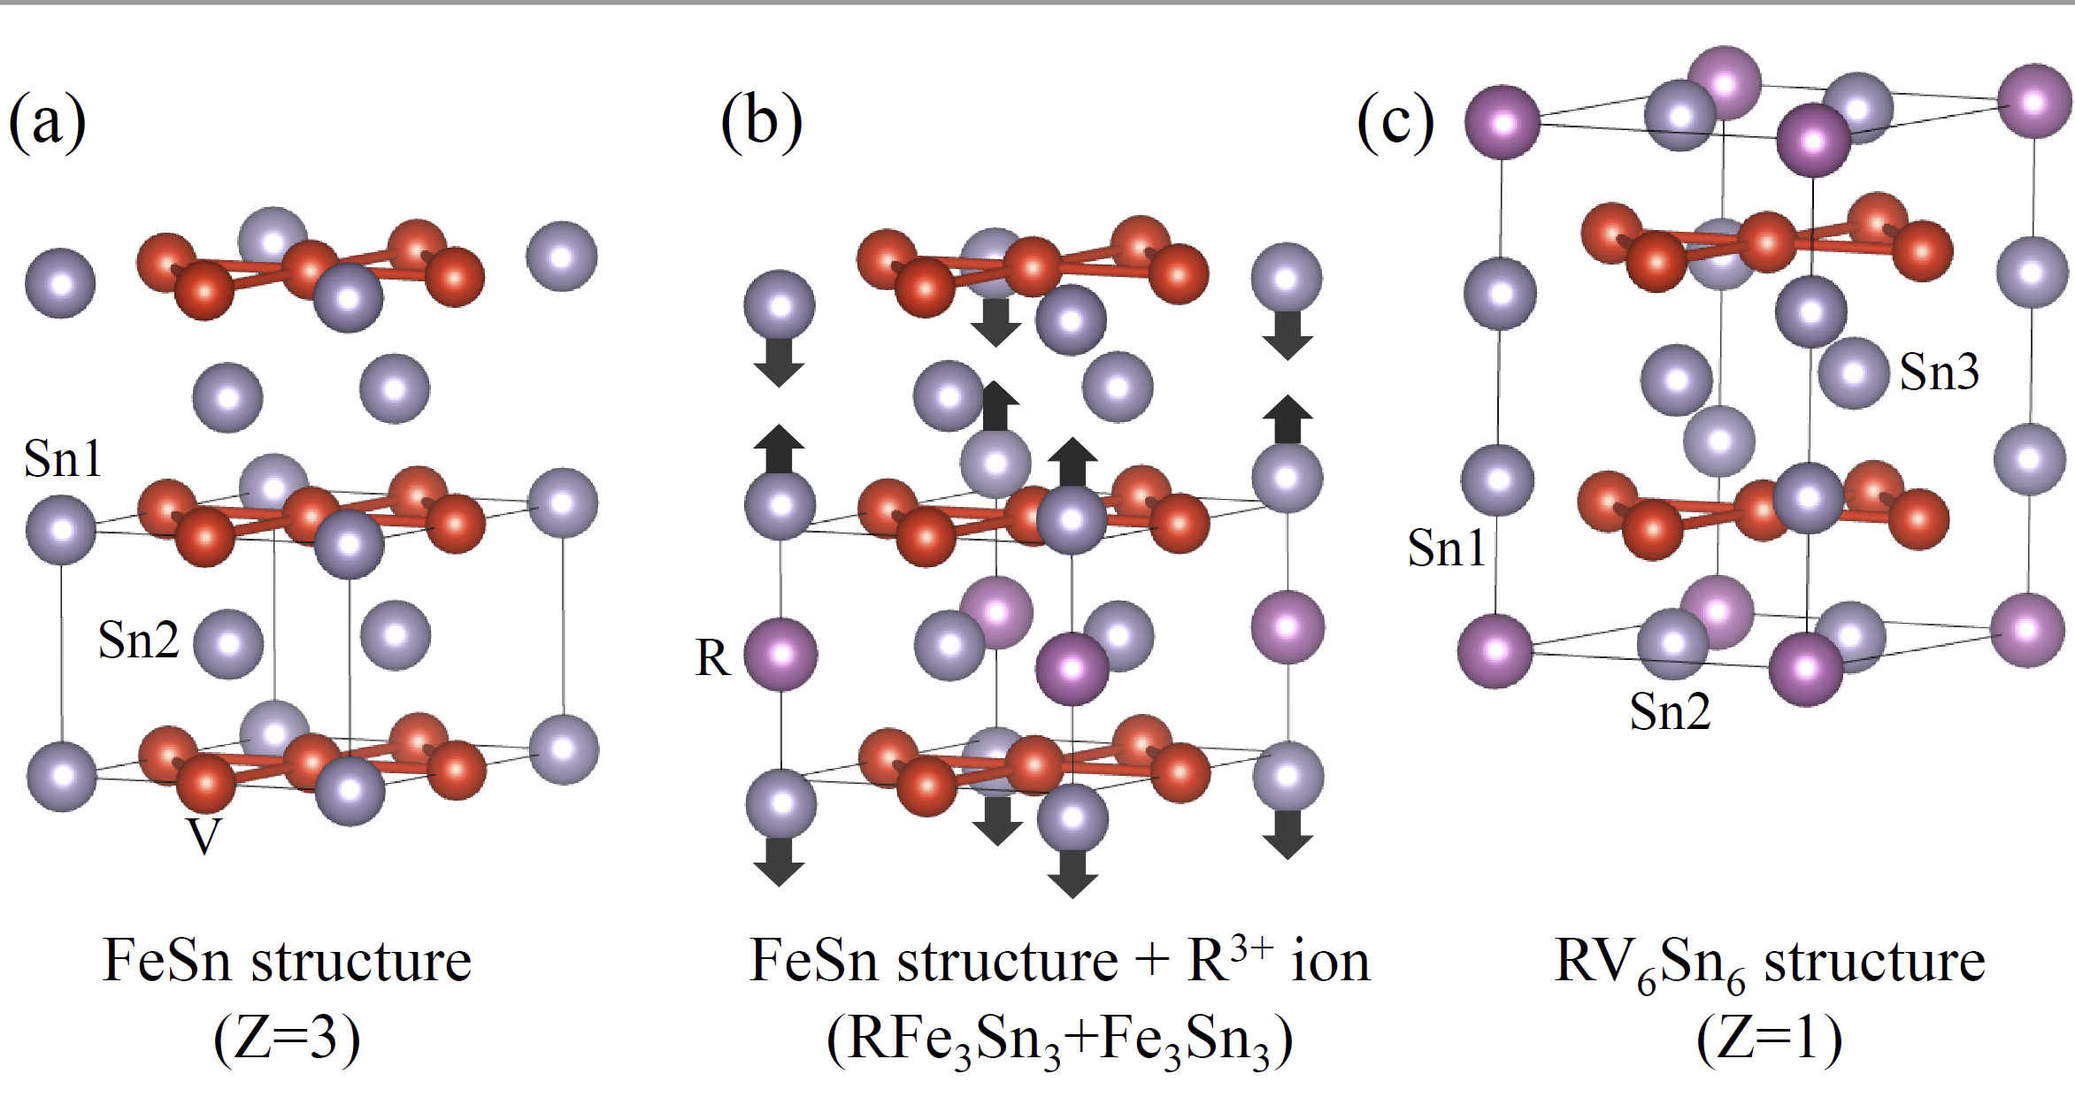
Material example 2: TbMn₆Sn₆
Bilayer kagome structure
Interstitial R-site ion forms triangular lattice
Tb
Pokharel et al., Phys. Rev. Mat (2023)
Mn

Slide 15
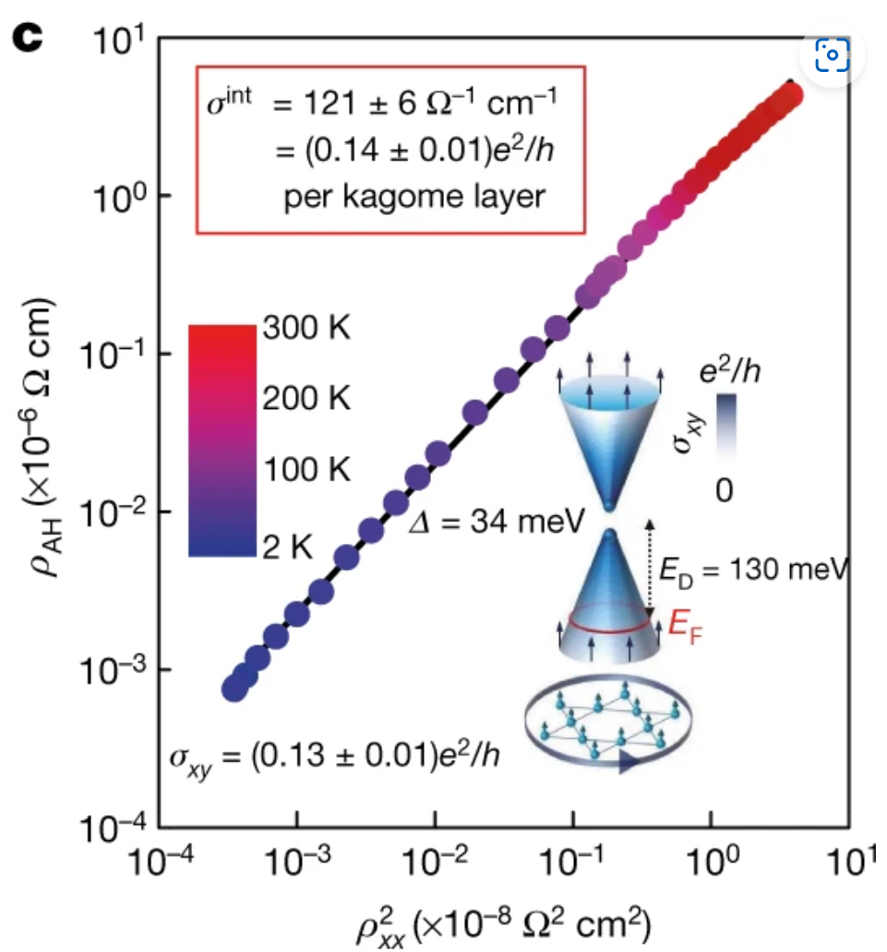
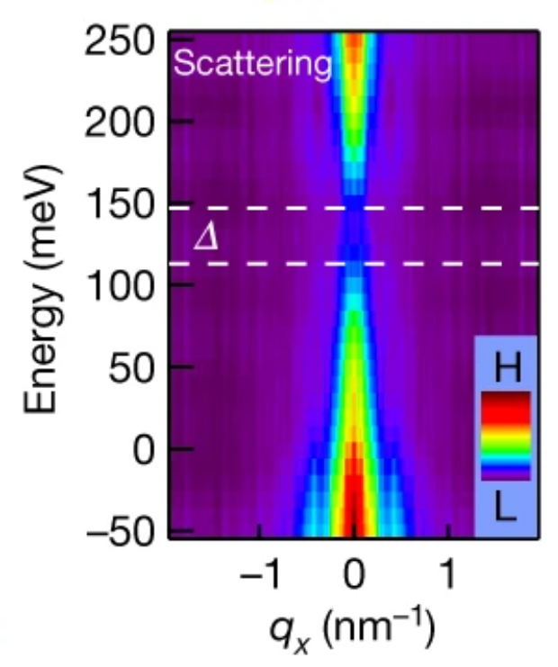
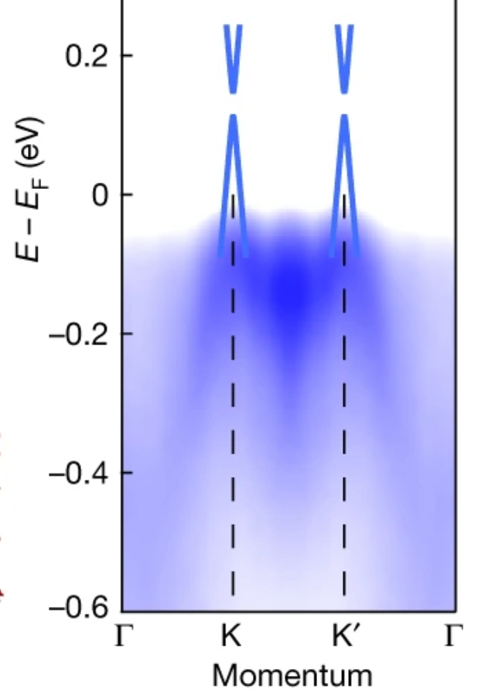
Material example 2: TbMn₆Sn₆
Y. X. Yin et al. Nature 583, 533 (2020).
Ferromagnetism, out-of-plane moments
Tb-induced by Mn-moments, strongly uniaxial

Slide 16
Kagome metals near VHS

Slide 17
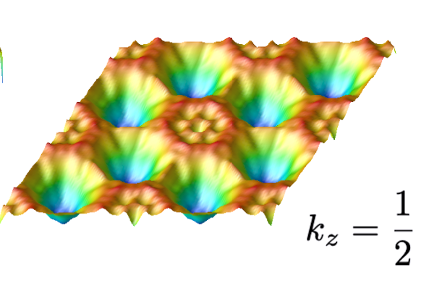
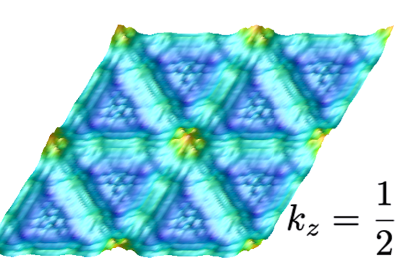
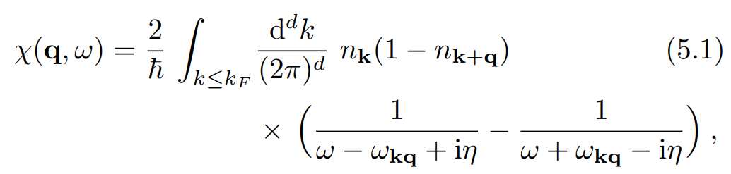


What can happen when near VH filling?
Johannes and Mazin, Phys. Rev. B 77, 165135 (2008).
Kabouvand et al, Appl. Phys. Lett. 120, 111901 (2022)
$$χ^{′}′(q,E)$$
$$χ^{′}(q,E)$$
M₃
M₁
M₂
“Nesting” of electronic states can occur at well-defined wave vector q
Creates peaks in χ′′(q) and χ′(q) of Lindhard response function
Promotes instabilities, electronic order

Slide 18
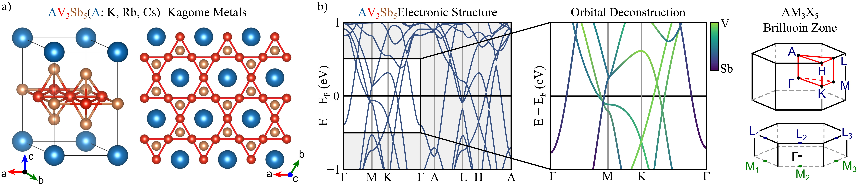
Material example 1: AV₃Sb₅ (A=K, Rb, Cs)

Slide 19
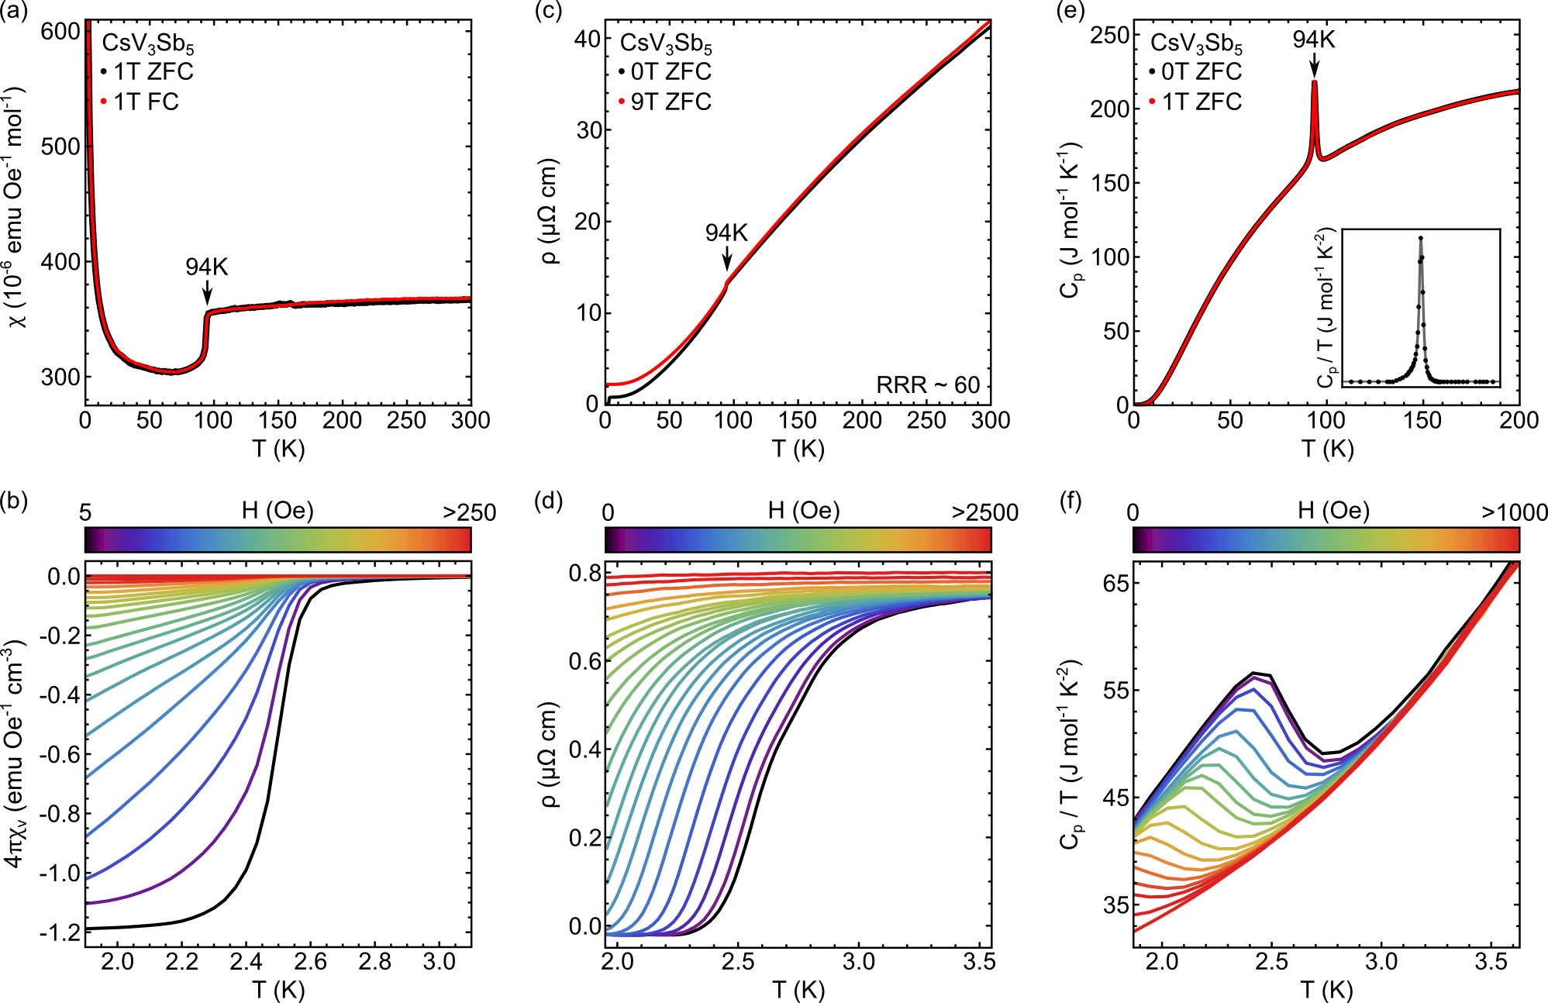
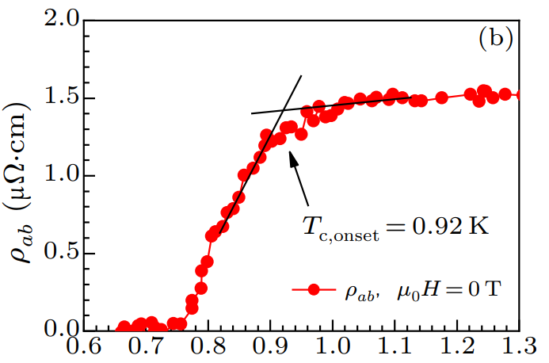
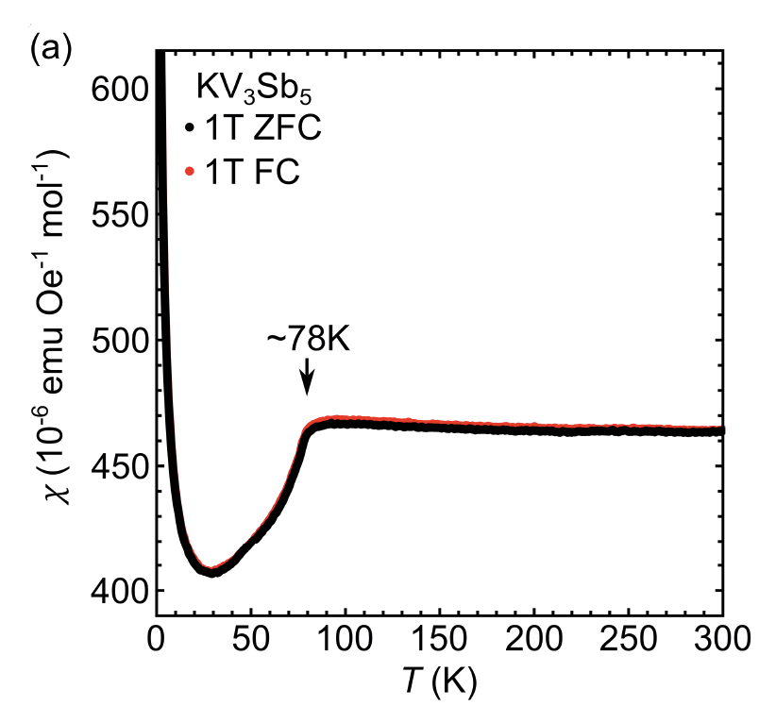
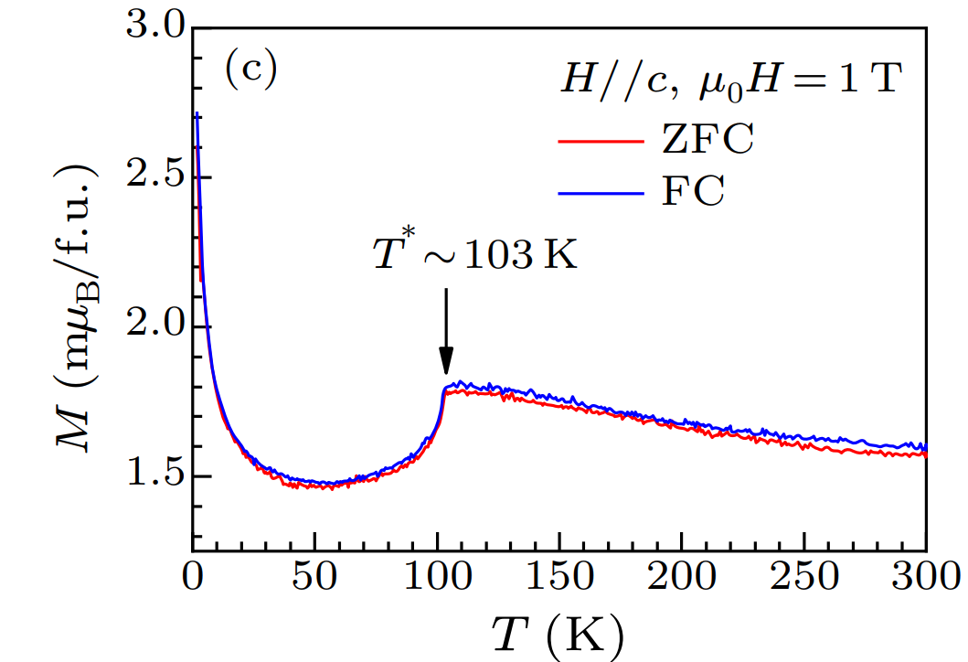
AV₃Sb₅ (A=K, Rb, Cs) as CDW superconductors
Ortiz et al., Phys. Rev. Lett. (2020)
Ortiz et al., Phys. Rev. Mat. (2021)
Yin et al., Chin. Phys. Lett. (2021)
A = Cs, T_{c}=2.5 K
A = K, T_{c}=0.9 K
A = Rb, T_{c}=0.75 K
A = Cs, T* = 94 K
A = K, T* = 78 K
A = Rb, T* = 104 K

Slide 20
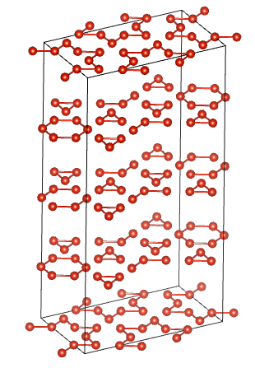
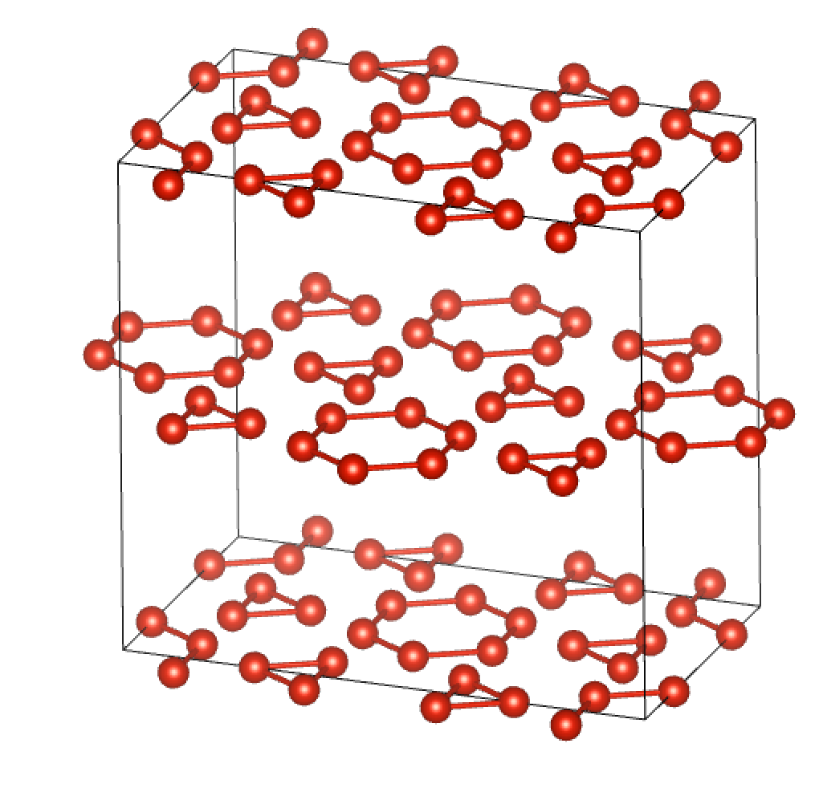
CDW structure: 2-fold rotational symmetry
CsV₃Sb₅
RbV₃Sb₅
KV₃Sb₅
SoD
TrH
TrH
TrH
SoD
L. Kautzsch et al., Phys. Rev. Mat. (2023)
Cmmm : 2×2×4 cell
Star of David mixed with tri-hexagonal
Fmmm : 2×2×2 cell
Staggered TrH distortion
Fmmm : 2×2×2 cell
Staggered TrH distortion

Slide 21
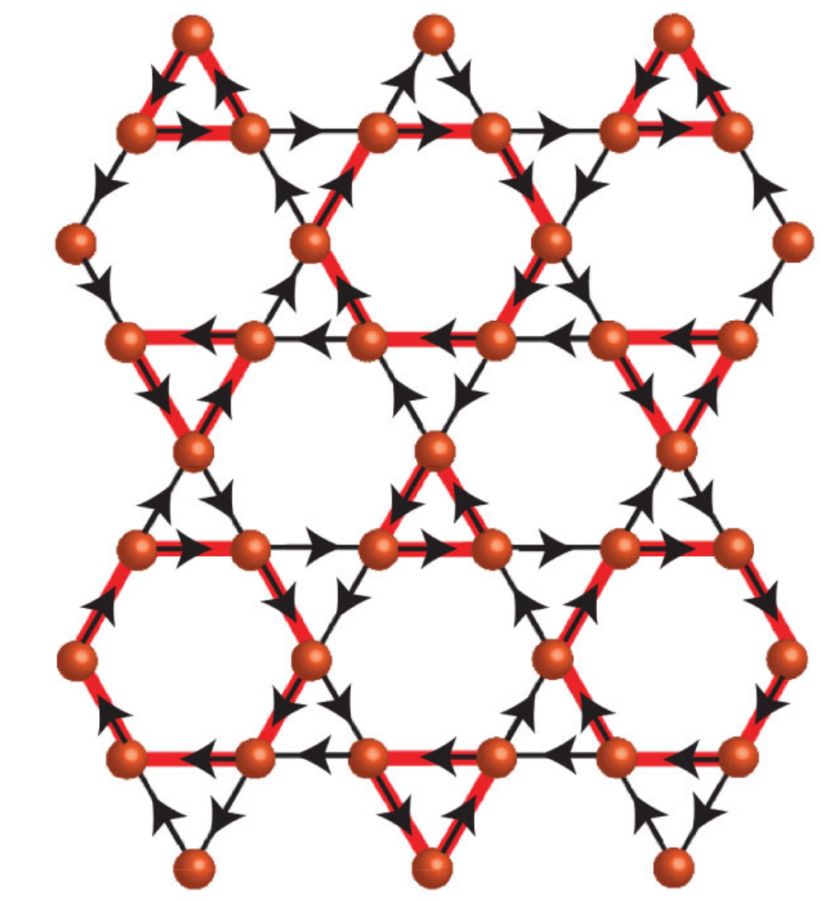
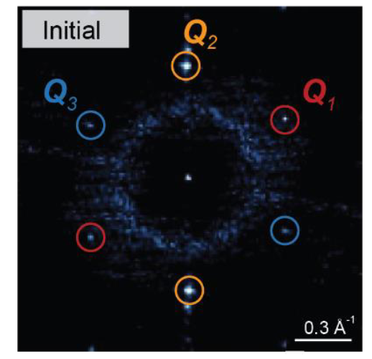
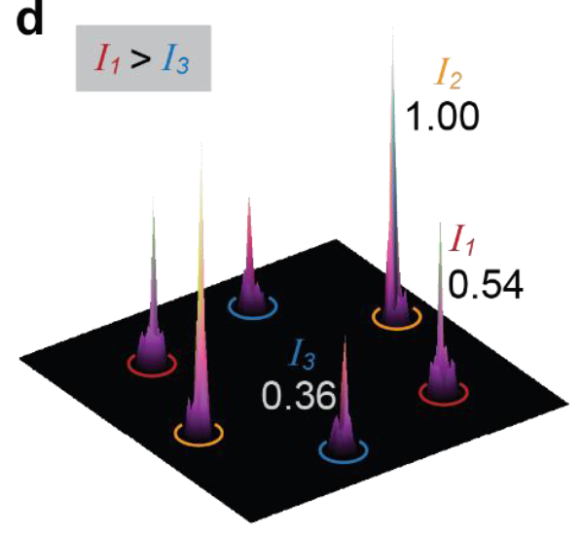
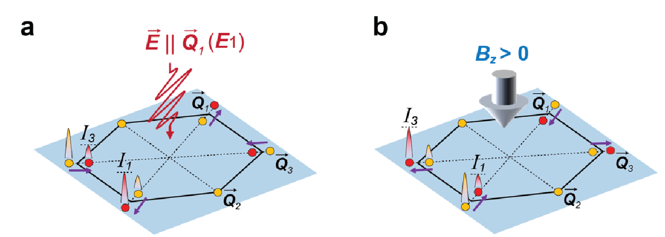
Cumulative signs of broken TRS in CDW state
Li et al., Phys. Rev. Lett 132, 146501 (2024)
Signatures of broken TRS in a number of probes
  μsR, STM, magnetotransport, Kerr, torque, …
Controversies exist in interpretation and reproducibility
Xing et al., Nature (2024).
Piezomagnetic response observed in STM and electron transport: TRS broken but signatures highly impacted by strain

Slide 22
Material example 2: RV₆Sn₆
MgFe₆Ge₆ structure type
P6/mmm space group
[V₃Sn2][RSn1][V₃Sn2][Sn3]
  L. Romaka et al. J. All. Comp. (2011)
Ideal V kagome net
Triangular lattice of R-site ions
Affords independent control of R-site magnetism and V-site kagome net
Ganesh Pokharel et al., Phys. Rev. B (2021)

Slide 23
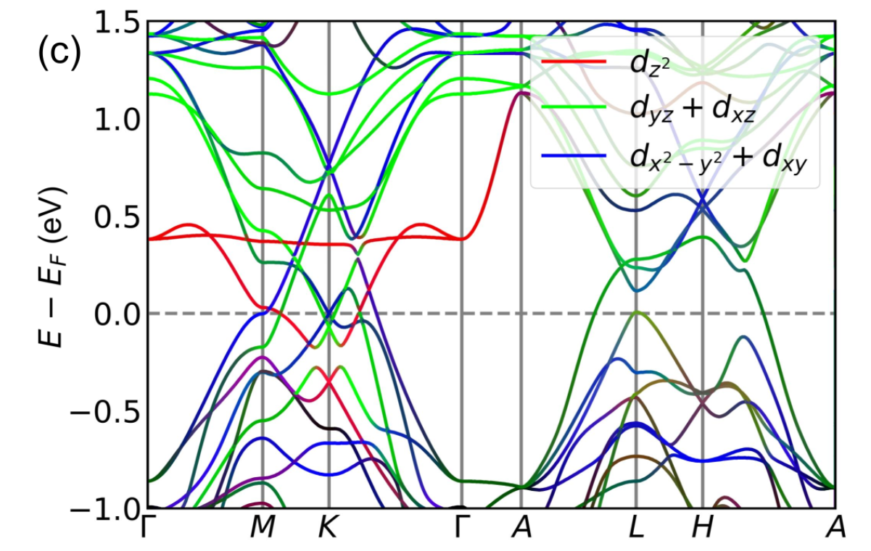
DFT bandstructure of RV₆Sn₆
YV₆Sn₆
Multiple magnetic ground states
R=Tb
  Strong uniaxial ferromagnet
  Pokharel et al., PRM (2022)
  E. Rosenberg et al., PRB (2022)
R=Gd
  Incommensurate multi-q order
  Porter et al., PRB (2023)
R=Er, Tm
  Easy-plane AF, no order
  Lee et al., PRM (2022)
Ganesh Pokharel et al., Phys. Rev. B (2021)
Flat band above ~0.4 above E_{F}
Dirac points at K-point and saddle points at M-point close to E_{F}

Slide 24
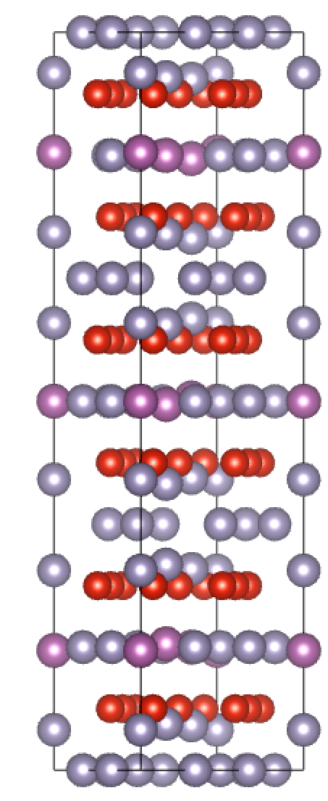
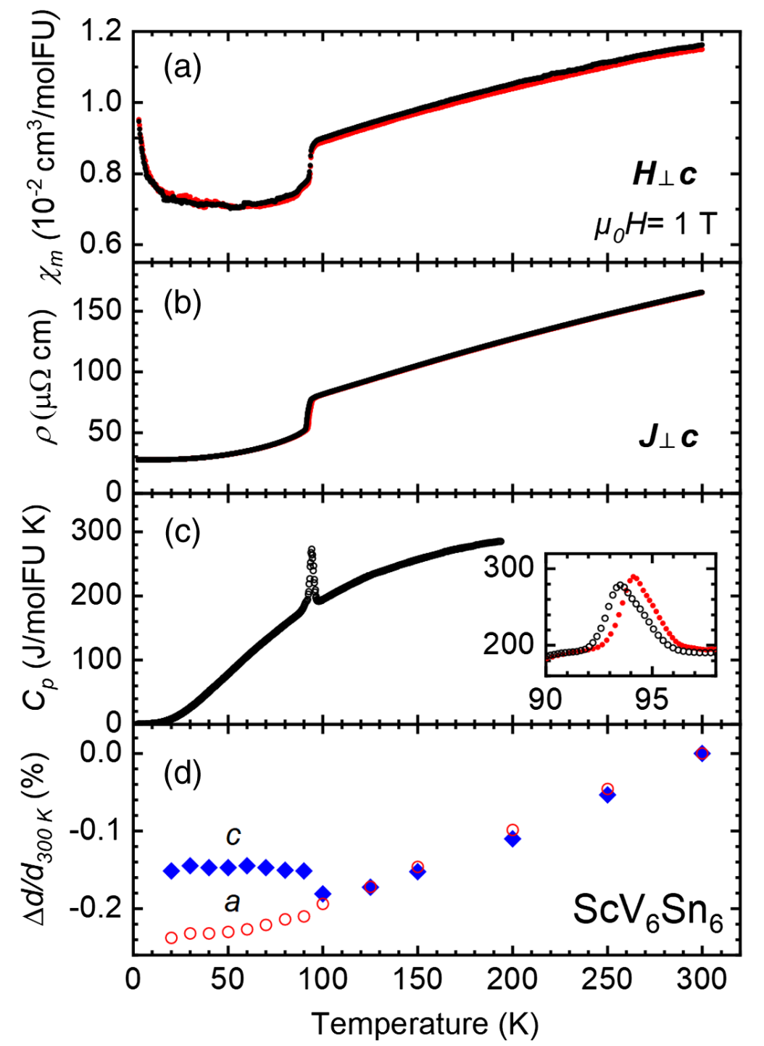
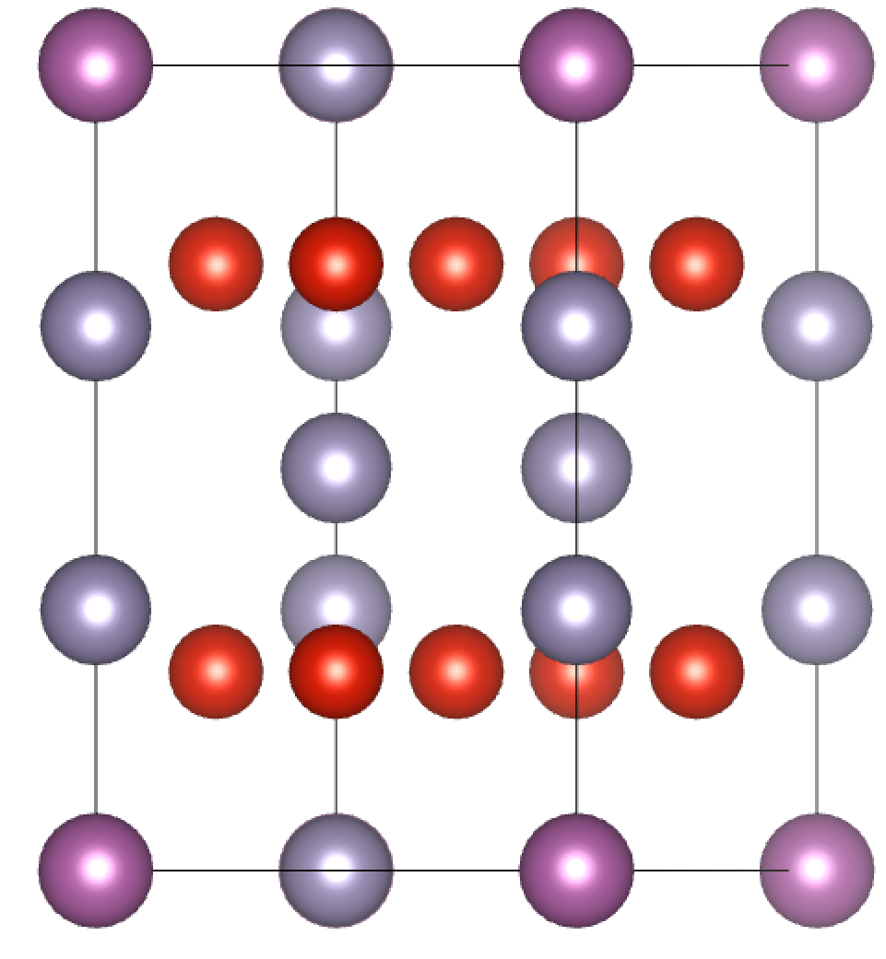

Charge order in ScV₆Sn₆ (R=Sc)
H. Arachchige et al., Phys. Rev. Lett. (2022)
q=(1/3, 1/3, 1/3)
$$\sqrt{3}×\sqrt{3}×3$$

Slide 25





Lattice distortion in ScV₆Sn₆
$$\sqrt{3}×\sqrt{3}×3$$
Tan and Yan, Phys. Rev. Lett. (2023)
$$\sqrt{3}×\sqrt{3}×2$$

Slide 26


High-temperature charge correlations
Pokharel et al., Physical Review Materials, 7, 104201. (2023).
See also: A. Korshunov et al., Nat. Comm. Nature communications 14, 6646. (2023).
q=(1/3, 1/3, 1/2)
$\sqrt{3}×\sqrt{3}×2$ type correlations

Slide 27




Real space, steric frustration
Primary: Peierls-like distortion of R-Sn-Sn chain
Secondary: Repulsion Sn-V_{plane} and distortion of kagome net
a
c
c
b
a
a
b
a

Slide 28



Another example: FeGe
Subires et al., arXiv:2408.04452v1 (2024)
H. Miao et al., Nature Communications 14, 6183 (2023)
Coupled magnetic order and charge order
Chain-like instability between Ge-ions

Slide 29


Another example: FeGe
Subires et al., arXiv:2408.04452v1 (2024)
High temperature signatures of frustrated dimer formation

Slide 30
Other examples: Beyond band picture

Slide 31


Material example 1: (Cs,Rb)Ti₃Bi₅
D. Verhahn et al., Zeitschrift für Naturforschung B (2022)

Slide 32

Heavily hole-doped cousin of (Cs,Rb)V₃Sb₅
D. Verhahn et al., Zeitschrift für Naturforschung B (2022)
No transitions evident down to 80 mK
Useful comparators to (Cs,Rb)V₃Sb₅
Initially appear to be “boring”, uncorrelated metals

Slide 33

Hints of hidden symmetry breaking in CsTi₃Bi₅
Hong Li et al. Nature Physics 19, 1591 (2023),
STM QPI reports 2-fold anisotropy
No rotational symmetry breaking detected in average structure

Slide 34


Material example 2: Mn₃(Sn,Ge) and related
Zhang et al., Phys. Rev. B 95, 075128 (2017).
Nakatsuji et al., Nature 527, 212 (2015)
Nayak et al., Science advances 2, e1501870 (2016).
Large room temperature anomalous Hall effect
Associated with real space Berry curvature of noncoplanar magnetic order

Slide 35
Large materials space

Slide 36


Layering Laves into stacked kagome
MgCu₂
Mg₂Cu₃Si
AB₂ into A₂B₃C
  Split the small spheres into two (B, C)
  Sufficient size difference in B and C orders
  Stacked kagome network results
Relatively unexplored space
  Notable examples in RM₃X₂
  Ta₂V₃Si is a recent example (T_{c}=7.5 K)
Liu et al., Phys. Rev. B 108, 104504 (2023).

Slide 37
Conclusions
Growing number of materials manifestations of some of the key ideas predicted in kagome metals
Materials space is large and, in many cases, highly tunable via chemistry
Future directions in engineering several of these instabilities in the same material platform (e.g. charge order + magnetism or charge order + SC)
Fun chemical ways to trying to create new layered kagome compounds out of three dimensional frameworks

