Slide 1
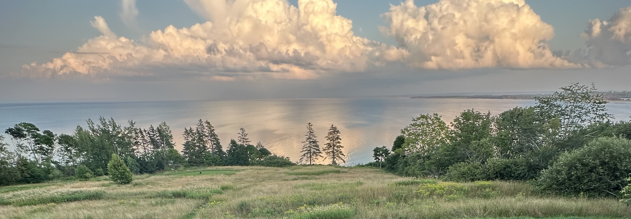
Topological Matter School
Topological Moire Materials
Allan MacDonald UT Austin
Notes:
I would first like to thank all of you for the opportunity to visit your department and for your hosptality. It is my pleasure to be here.
My topic today relates to some rather simple but fundamental and subtle ideas in quantum statistical physics and to the possibility that they can be exploited in
new types of electronic devices. My ultimate goal today is to talk about a type of potential magnetic switch involving spin supercurrents, but I will start by talking about
closely related phenomena in systems with Bose condensates of excitons.

Slide 2
Twisted Graphene Summary
8 Flat Bands – 2 per spin-valley Flavor
Insulating States Possible For $ν=0, ±1$per bilayer
$ν=0$ flavors contribute to the Hall conductivity
due to spontaneous sublattice polarization

Slide 3
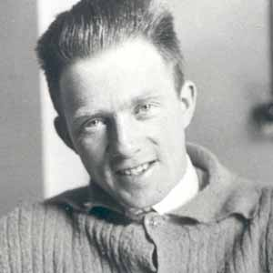
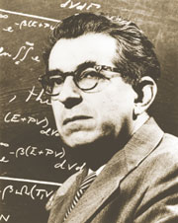
Werner Heisenberg
Fritz London

Slide 4
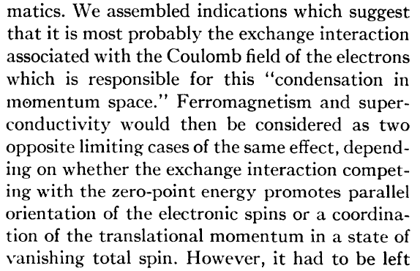
F. London Phys. Rev. 74 (1948)
Notes:
The same thing can happen with other degrees of freedom – as already observed in this old paper by Fritz London. London was actually looking for a theory of superconductivity and speculating that it might be due to many-body quantum states that spontaneously carry a current because energy is gained by occupying states that are close together in momentum space. This paper is actually one of a number of interesting but incorrect theories of superconductivity. As I’ll comment later it might however be closely related to new physics that can occur in bilayers.

Slide 5
Observation of AHE at $ν=3$ in MATBG
Accurately Quantized
Anomalous Hall Effect
in MATBG at $υ=3$
Sharpe et al. Goldhaber-Gordon group (Stanford) Nature (2019)
Serlin et al. (Young Lab – UCSB) - Science (2020)

Slide 6
Twisted TMD Homobilayers

Slide 7
 | MoS₂ | MoSe₂ | MoTe₂ | WS₂ | WSe₂
MoS₂ | Homo ?
MoSe₂ | (S,Se) | Homo Gamma
MoTe₂ | (S,Te) | (Se,Te) | Homo K
WS₂ | (Mo,W) | (S,Se) | (Se,Te) | Homo Gamma
WSe₂ | (Se,Se) ? (S,Se) | (Mo,W) | (Se,Te) | (S,Se) | Homo ?

Slide 8
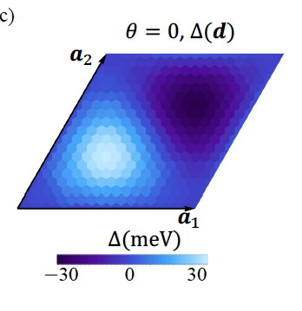
Hubbard Model Simulator
WSe₂/MoSe₂
W
Mo
Spinful Electrons in Periodic Potential
Vastly Tunable Band widths
Can be cooled
Holes
W
W
on Se
Mo
Wu, Lovorn & AHM PRL, 121 026402 (2018)

Slide 9
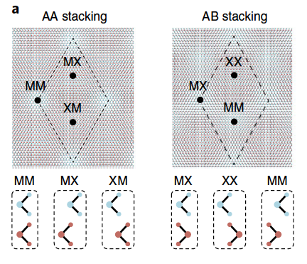
TMD Stacking Pattern Variation
Mak Shan Nature Nanotech. (2022)

Slide 10
Layer Pseudospins
in TMD
AA Homo/Heterobilayers
A Surprise Skyrmion Lattice
In MoTe₂ Homobilayers !
TMD AA Homobilayer Theory – Wu et al. - PRL (2019)

Slide 11
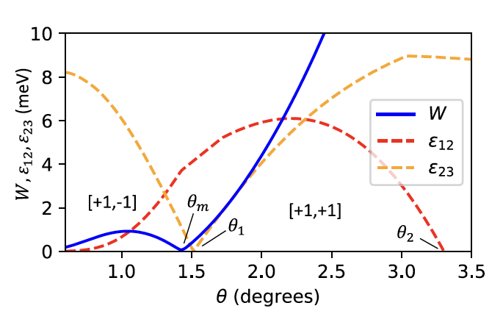
Magic Angles
Magic Angle Condition
Bandwidth vs.
Moiré Period
A Surprise !
Magic Angles !
Devakul et al. Nature Comm. (2021)
Crepel et al. PRB (2023)

Slide 12
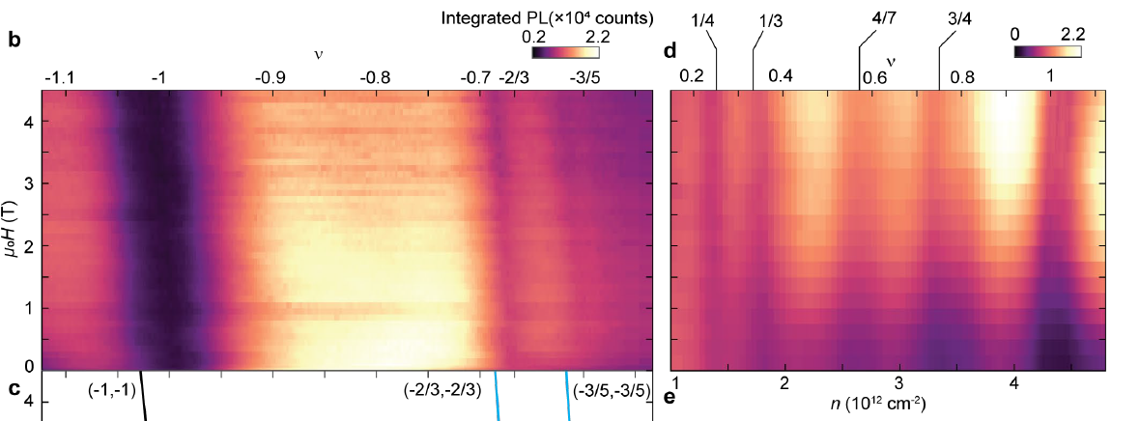
Quantum Anomalous Hall Effect and
Fractional QAHE in MoTe₂ bilayers
A Surprise !
Fractional Chern
Insulators !
Cai et al. (Xu lab) Nature (2023)
Zeng et al. (Mak Shan lab) Nature (2023)

Slide 13
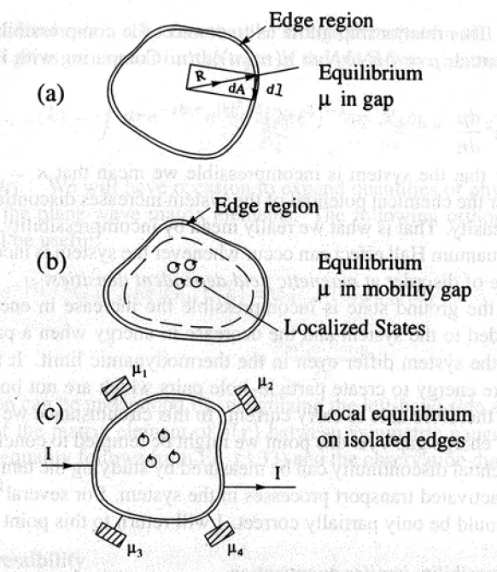
Fractional Chern Insulators are Strange
Quantum
Hall Gap
$$\frac{ðN}{∂B}≠0$$
$$\frac{ðN}{∂B}=\frac{ðM}{∂μ}$$
$$σ_{H}=\frac{1}{Φ_{0}}\frac{ðN}{∂B}$$
(Streda Formula)
Les Houches 1994: Mesoscopic Quantum Physics
Akkermans et al.

Slide 14
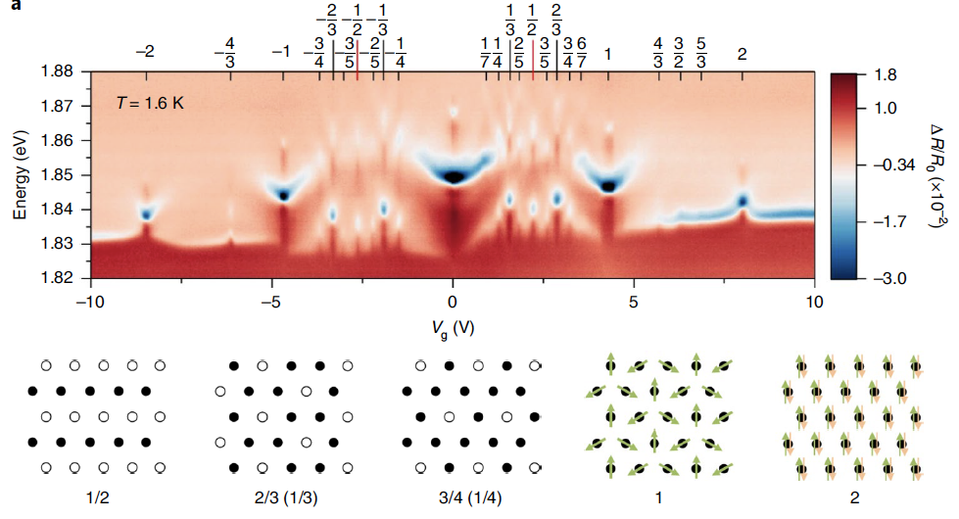
FCIs are Strange – Wigner Crystals are Not
WSe₂/WS₂
Mak Shan (Cornell) - Friday

Slide 15
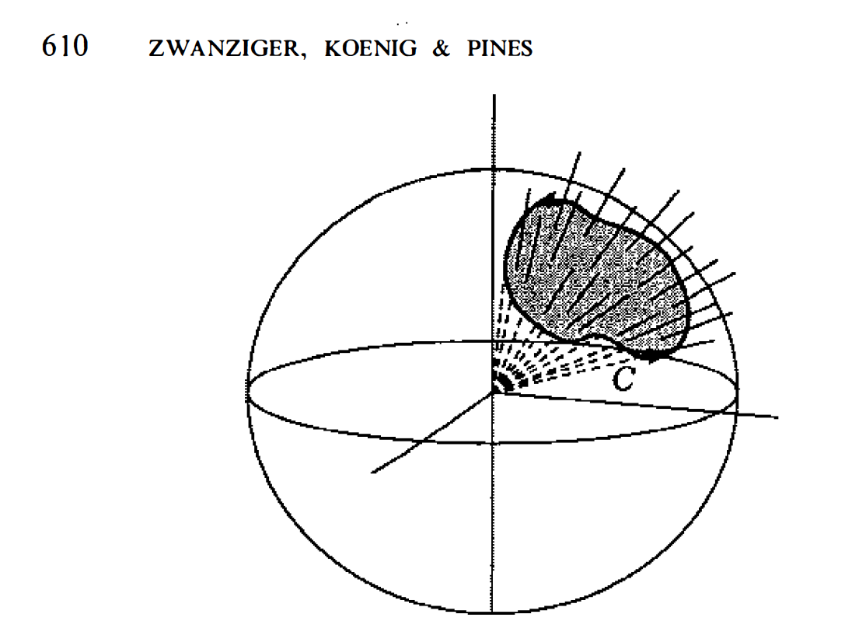
Bloch Spheres and Berry Phases
Berry , TKNN, and ASS
QAHE in 2D insulators
Layer Spinor
Bloch Sphere
$$Ψ=\left(\begin{matrix}ψ_{t} \\ ψ_{b}\end{matrix}\right)=\left(\begin{matrix}\cos{\frac{θ}{2}} \\ e^{iφ}sin{\frac{θ}{2}}\end{matrix}\right)$$
y
X

Slide 16
Aharonov-Casher
PRA vol. 19 p. (2461) 1979
LLL in Varying Magnetic Field
0
LLL = Lowest Landau Level

Slide 17
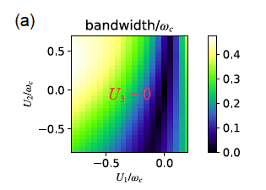
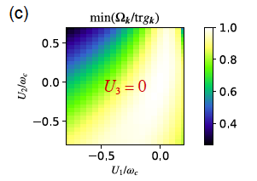
AC Magic Angles
$U\left(\vec{r}\right)$ = $− ℏω_{c}\left(\vec{r}\right)+\left(Δ_{0}\left(\vec{r}\right)+\left|\vec{Δ}\left(\vec{r}\right)\right|\right)+D(\vec{r})$
Morales-Duran, Shi, et al. PRL, PRB (2024)
Kolar, Yang, von Oppen, Mora arXiv:2406.06680

Slide 18
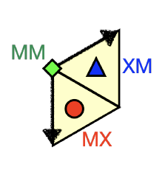
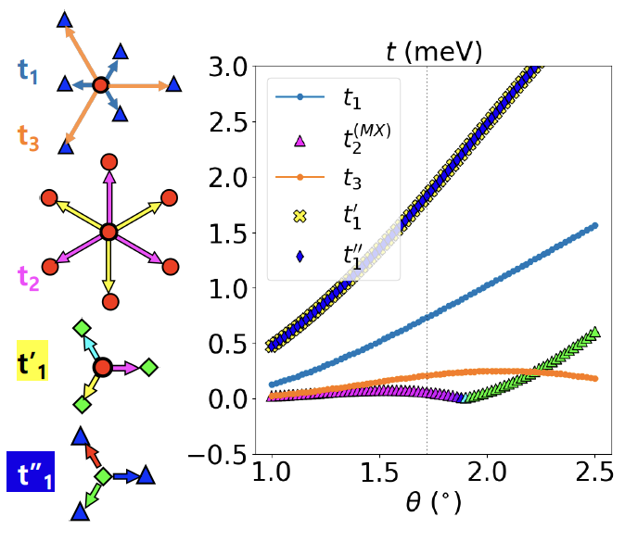

Slide 19
= MM
= XM
= MX

Slide 20
Topological Magnetoelectric
Effect

Slide 21
Two Dirac Cone Families
Gapped Dirac Cone
=
1/2 QHE
Bi₂Se₃ - Moore – Nature (2010)
Graphene – AHM - Physica Scripta (2012)

Slide 22
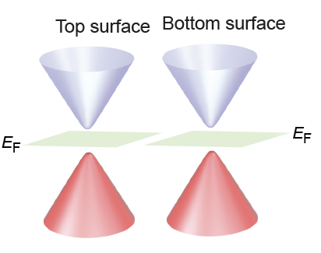
Quantum Hall Effect Using TI Surface States
Two Surfaces
=
Two-Dirac Cones
+
Magnetism
=
Quantum
Anomalous Hall
Effect
(Qi et al. 2008)

Slide 23
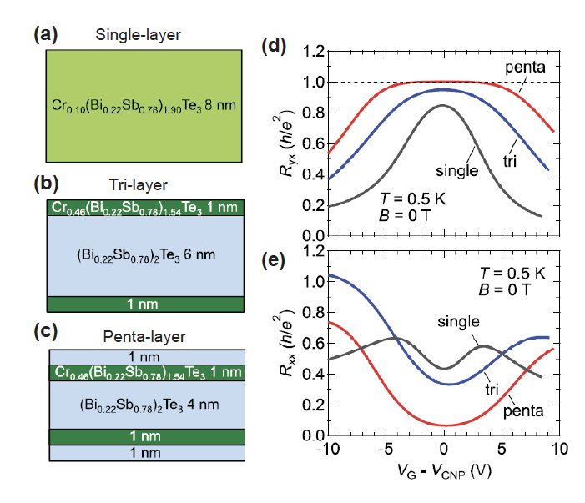
Surface Layer Magnetism and QAHE
Only
Surface
Magnetism
Matters
Mogi, … Tokura APL (2015)

Slide 24
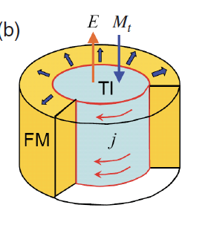
Topological Magnetoelectric Effect
Qi and Zhang, RMP (2011)

Slide 25
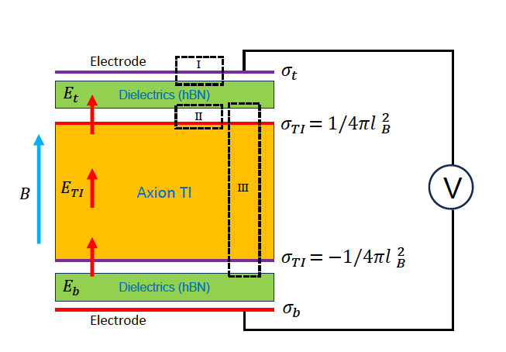
Capacitive Measurement of the TME
Mahon, Lee, AHM – arXiv:2024
Phys. Rev. Res (2024)

Slide 26
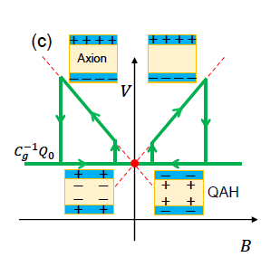
Capacitive Measurement of the TME

Slide 27
Dirac Cone Model for BX/MBX materials
Lei, Chen & AHM, PNAS (2020)
Lei, Heinonen, AHM & McQueeney –
PRM (2021) & arXiv:2110.00890
Lei & AHM – PRR (2021)
Chao Lei & AHM – - PNAS (2020)

Slide 28
Does the Model Work? - Bulk
$$Δ_{S}$$
$$Δ_{D}$$
= top
= bottom
$Δ_{S} and { Δ}_{D} have opposite signs$
$Δ_{D}^{1} is small$

Slide 29
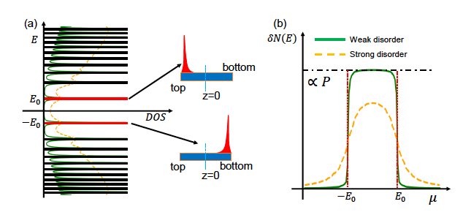
Is the TME quantized ?

Slide 30
Topological Matter School
Topological Moire Materials
Allan MacDonald UT Austin
Notes:
I would first like to thank all of you for the opportunity to visit your department and for your hosptality. It is my pleasure to be here.
My topic today relates to some rather simple but fundamental and subtle ideas in quantum statistical physics and to the possibility that they can be exploited in
new types of electronic devices. My ultimate goal today is to talk about a type of potential magnetic switch involving spin supercurrents, but I will start by talking about
closely related phenomena in systems with Bose condensates of excitons.

