Slide 1

Topological Matter School
Topological Moire Materials
Allan MacDonald UT Austin
Notes:
I would first like to thank all of you for the opportunity to visit your department and for your hosptality. It is my pleasure to be here.
My topic today relates to some rather simple but fundamental and subtle ideas in quantum statistical physics and to the possibility that they can be exploited in
new types of electronic devices. My ultimate goal today is to talk about a type of potential magnetic switch involving spin supercurrents, but I will start by talking about
closely related phenomena in systems with Bose condensates of excitons.

Slide 2
Moire Materials

Slide 4
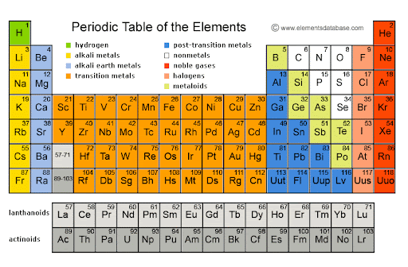
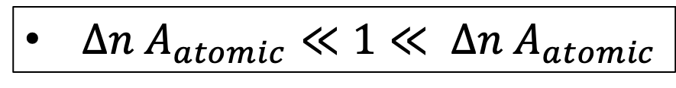
Chemistry by Gating
$Δn A_{atomic}≪1≪ Δn A_{atomic}$

Slide 5
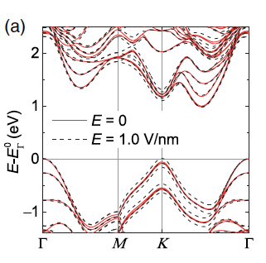
Moiré + Semiconductors or Semimetals
= Moiré Materials
Graphene
WSe₂
Notes:
The main part of my talk will be on a specific aspect of TBG physics.
Since I am speaking first though I will start with a brief perspective on the topic of this workshop for those who are new to it.
First of all I have been trying to establish the …

Slide 6
Berry Curvature

Slide 7


Anomalous Velocity and Topology
Interband Response
Quantum Geometry
Notes:
The main part of my talk will be on a specific aspect of TBG physics.
Since I am speaking first though I will start with a brief perspective on the topic of this workshop for those who are new to it.
First of all I have been trying to establish the …

Slide 8
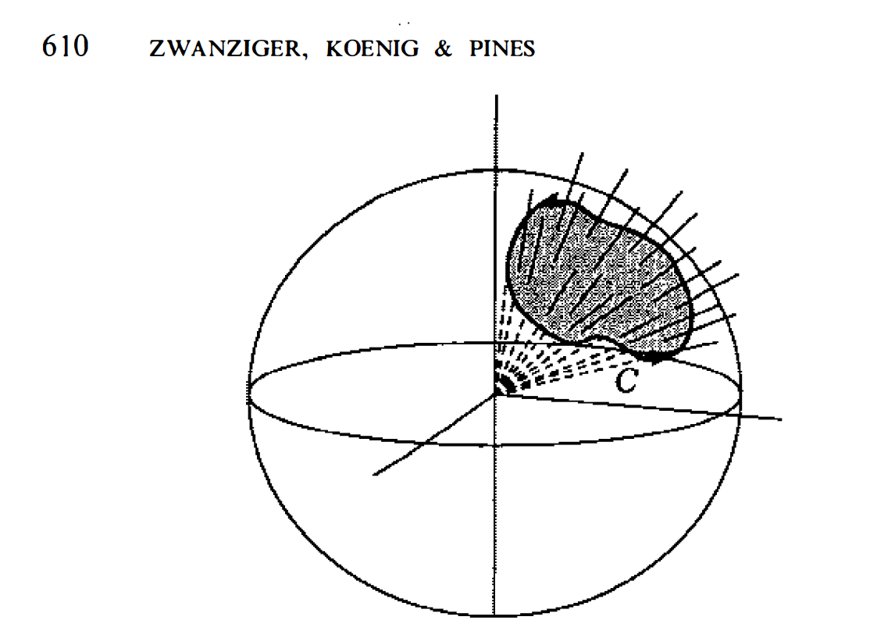
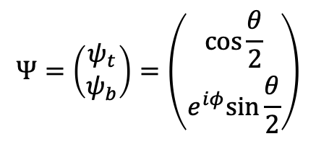
Bloch Spheres, Berry Phases
and Quantized Hall Conductance
Berry , TKNN, and ASS
QAHE in 2D insulators
Bloch Sphere
$$Ψ=\left(\begin{matrix}ψ_{t} \\ ψ_{b}\end{matrix}\right)=\left(\begin{matrix}\cos{\frac{θ}{2}} \\ e^{iφ}sin{\frac{θ}{2}}\end{matrix}\right)$$
y
X

Slide 9

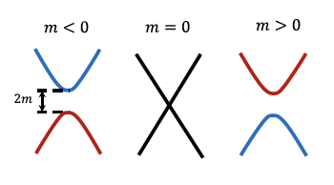
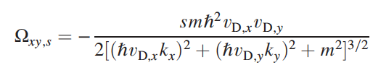
Dirac Cones and Level Crossing
Half-Quantum Hall Effect

Slide 10
Graphene Multilayers

Slide 11
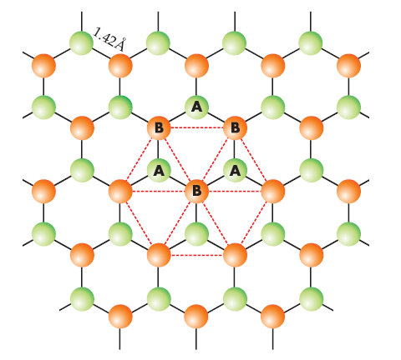
Sublattice-Pseudospins
A
B
Notes:
The aspect of graphene physics that I will focus on is the role of the sublattice pseudospin in electron correlation physics.
The sublattice degree of freedom is associated of course with the two-atoms per unit cell on a honeycomb lattice as has been discussed by a number of other speakers.

Slide 12
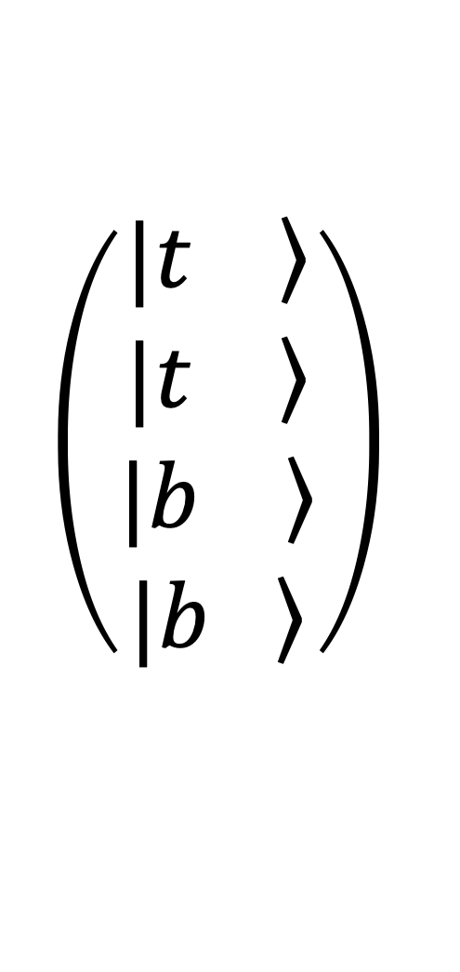
$$\left(\begin{aligned}\left.|t \right\rangle \\ \left.|t \right\rangle \\ \left.|b \right\rangle \\ \left.|b \right\rangle \end{aligned}\right)$$
A
B
A
B
Bilayer Graphene Energy Bands
Notes:
Graphene has remarkably simple electronic structure of course. The crystal is composed entirely of carbon atoms and only one carbon orbital
matters at low energies. The carbon atom atoms sit on a honeycomb latties which has two sublattices. The end result is that matter waves in graphene
Occupy momentum dependent sublattice states.

Slide 13
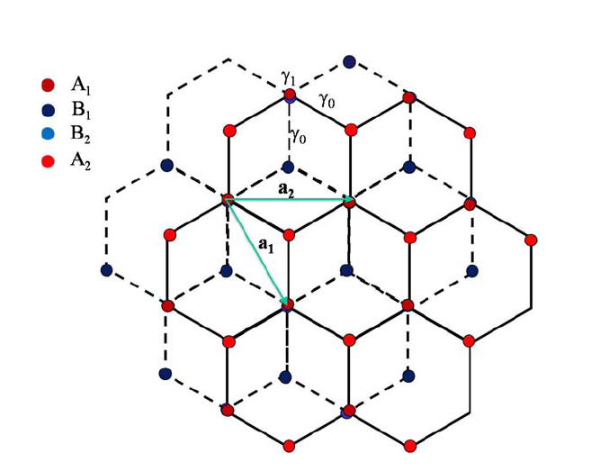
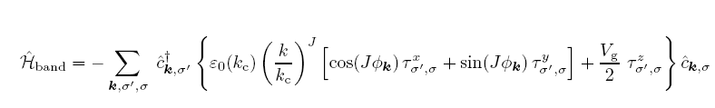
Bilayer AB stacking
A₂
B₂
A₁
B₁
Novoselov et al. – Nature Phys. (2006)
McCann & Falko – PRL (2006)
Notes:
In bilayers the sublattice sites of interest have no near neighbors in the other layer – again there are two of them
and they are located on opposite layers. The band Hamiltonian has chirality 2 – i.e. the direction of the pseudospin effective
field varies twice as fast as the direction of momentum as others have mentioned – that’s the J=2 case of this Hamiltonian.
If there’s a potential difference between the layers a gap will open. The second part of my talk concerns the possibility of these
Gaps emerging spontaneously in FLG systems due to electron-electon interactions.

Slide 14
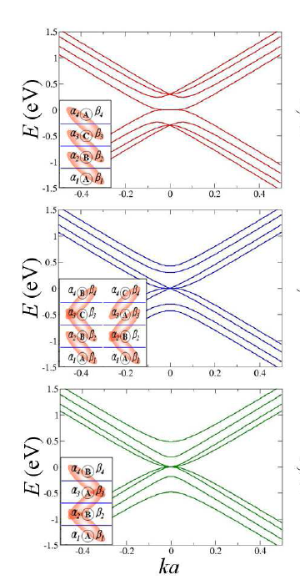
Pseudospins in Graphene Stacks
inequivalent
4-layer graphene stacks
Min et al. PRB (2008)

Slide 15

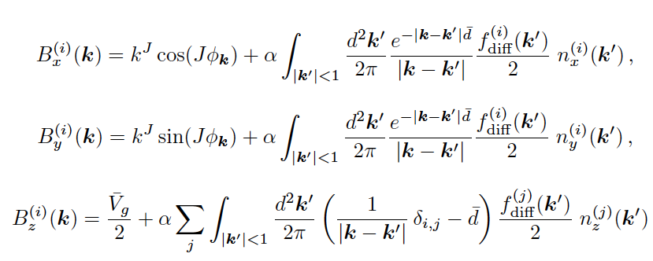
Interactions Don’t Like Dirac Points
Pseudospin
Magnetic
Field
Min et al. PRB (2008)

Slide 16
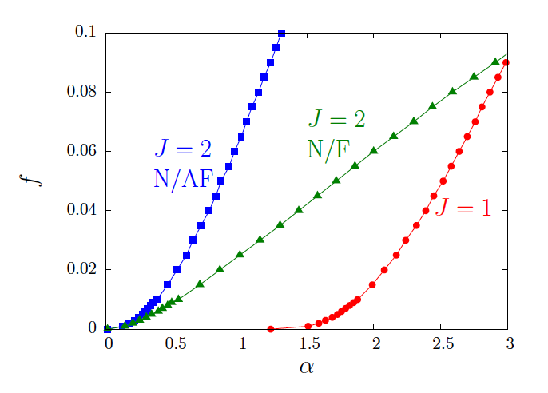

Interactions Don’t Like Dirac Points
Min et al. PRB (2008)

Slide 17
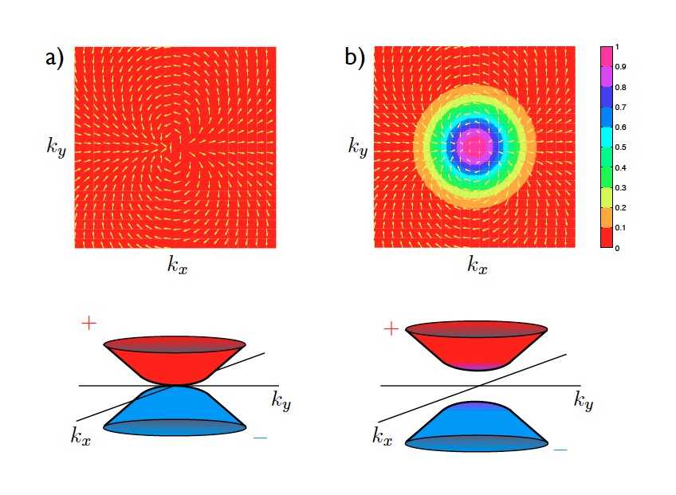
Chiral Symmetry Breaking
And Band Topology
Min et al. PRB (2008)
Phys. Scripta (2012)
TMD Homobilayers:
Wu et al. PRL (2019)

Slide 18
Spin/Valley/Layer
pseudospins in Bilayer Graphene
There are eight
low-energy bands in bilayer
Graphene
one state at each
momentum for
each state in a
spinxvalleyxlayer.

Slide 19
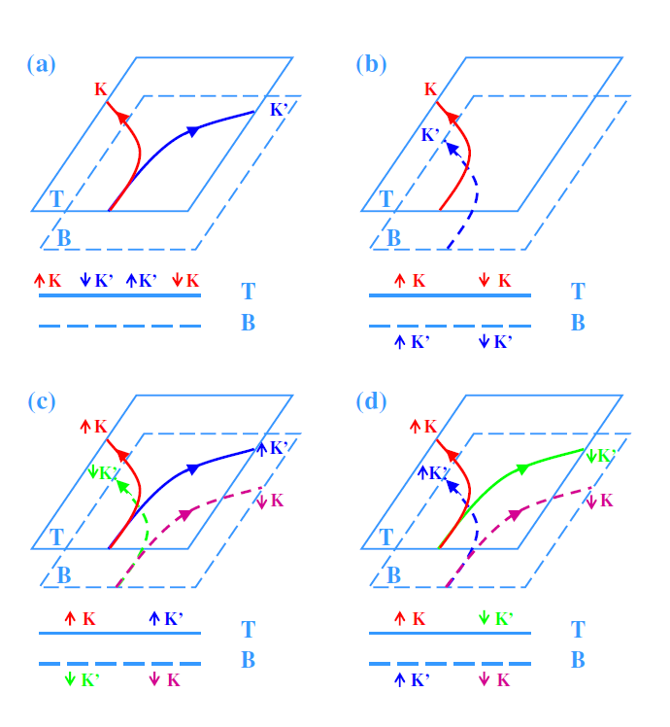
= `ferro’
σ_{Hall} =0
(b) = `anomalous Hall insulator’
(Levitov)
σ_{Hall} 0
(c)= `layer AF insulator’
σ_{Hall} =0
(d) = `spin Hall insulator’
σ_{Hall} =0
Fan Zhang , R. Nandkishore arXiv:1002.1966
Vafek PRB (2010), Fan Zhang PRB (2010)

Slide 20
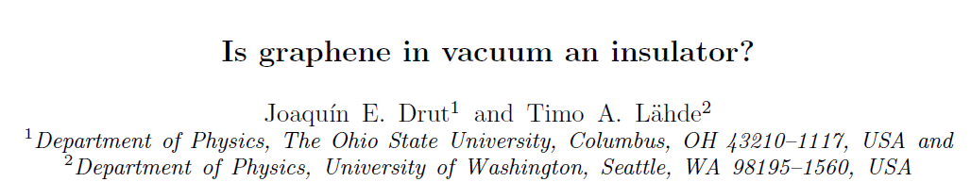
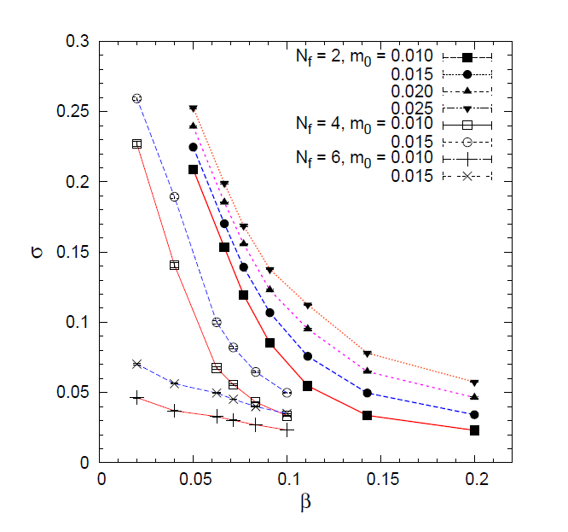
Drut/Lahde
PRL (2009)
Lattice Gauge Theory
Chiral Symmetry Breaking ?
Notes:
The interacting electron problem with graphene is similar to QFT and can be tackled with similar numerical methods.
This is a graph from an effort in this direction by
Timo Lahde – sitting at the back there. One conclusion from these studies is that calculating
Masses in graphene is not so much easier than calculating masses of nucleons.

Slide 21
Twisted Graphene Multilayers

Slide 22

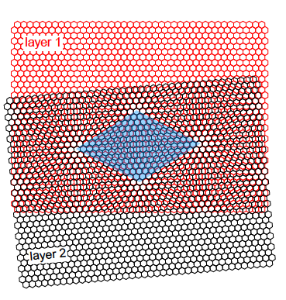

Slide 23
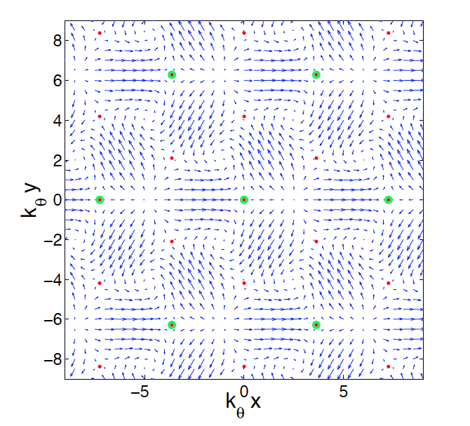
Periodic Tunneling Hamiltonian
Bistritzer PNAS (2011)
AA
BA
Moiré
Modulated
Sublattice
Dependent
Tunneling
AB
T_{AB}(r)

Slide 24
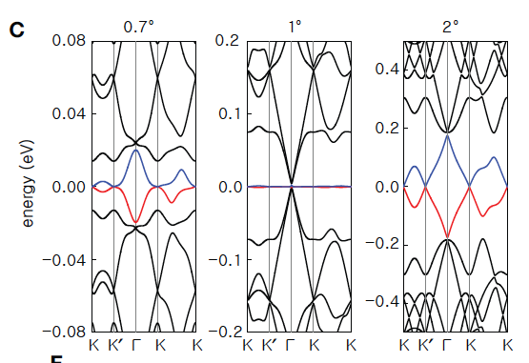
Magic Angles !
Universal !
$$μ$$
$$γ$$
$$μ$$
Bistritzer and AHM PNAS (2011)
also Morrell et al. PRB (2010)

Slide 25
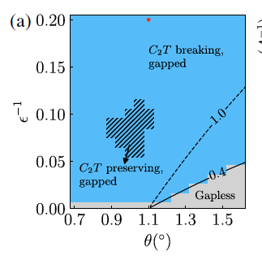

Slide 26
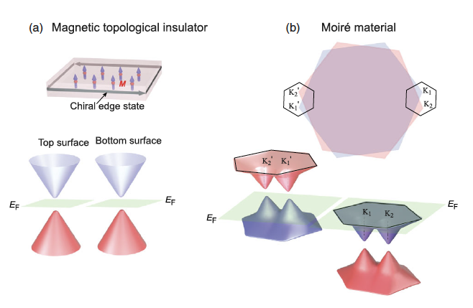

Slide 27
Fermi Surface Reconstructions
Saito et al.
Nature (2021)
(Hall Density)

Slide 28
Topological Matter School
Topological Moire Materials
Allan MacDonald UT Austin
Notes:
I would first like to thank all of you for the opportunity to visit your department and for your hosptality. It is my pleasure to be here.
My topic today relates to some rather simple but fundamental and subtle ideas in quantum statistical physics and to the possibility that they can be exploited in
new types of electronic devices. My ultimate goal today is to talk about a type of potential magnetic switch involving spin supercurrents, but I will start by talking about
closely related phenomena in systems with Bose condensates of excitons.

